Slide 1
Basics of Financial Aid
Cathy Hill
Assistant Director of Financial Aid

Slide 2
Agenda
Financial Aid
Cost of Attendance (COA)
Student Aid Index (SAI)
Financial Need
Sources of Financial Aid
Applying for Financial Aid
Special Circumstances

Slide 3
Financial Aid
Grants & Scholarships
“Gift Aid”
Merit or Need-Based
Loans & Employment Opportunities
“Self-Help Aid”
Need or Non-Need Based

Slide 4
Cost of Attendance (COA) “The Budget”
Determined by the college or university
Direct costs
Indirect costs
Vary widely from college to college

Slide 5
Cost of Attendance (COA)
Tuition and Fees
Room and Board
Books and Supplies
Transportation
Personal Expenses
computer, travel abroad, child care, etc.

Slide 6
Cost of Attendance Comparison
 | Private | Public In-State | Community College
Tuition & Fees | $39,400 | $10,940 | $3,860
Room & Board | $14,030 | $12,310 | $9,610
Books & Supplies | $1,240 | $1,240 | $1,460
Transportation | $1,070 | $1,250 | $1,870
Personal | $1,830 | $2,200 | $2,430
Total | $57,570 | $27,940 | $19,230
Source: The College Board, Trends in College Pricing 2022

Slide 7
Financial Aid Philosophy
In addition to the various types of aid available, the student and parent(s) are expected to contribute to paying for the overall Cost of Attendance.

Slide 8
Student Aid Index (SAI)
Replaces the Expected Family Contribution (EFC)
Amount family can reasonably be expected to contribute toward college costs
Calculated by a federal formula using family income, asset, and household size information

Slide 9
Student Aid Index
Stays the same regardless of college
Two components:
Parent Contribution
Student Contribution
Not a bill!!!

Slide 10
Financial Need
Cost of Attendance
– Student Aid Index
= Financial Need

Slide 11
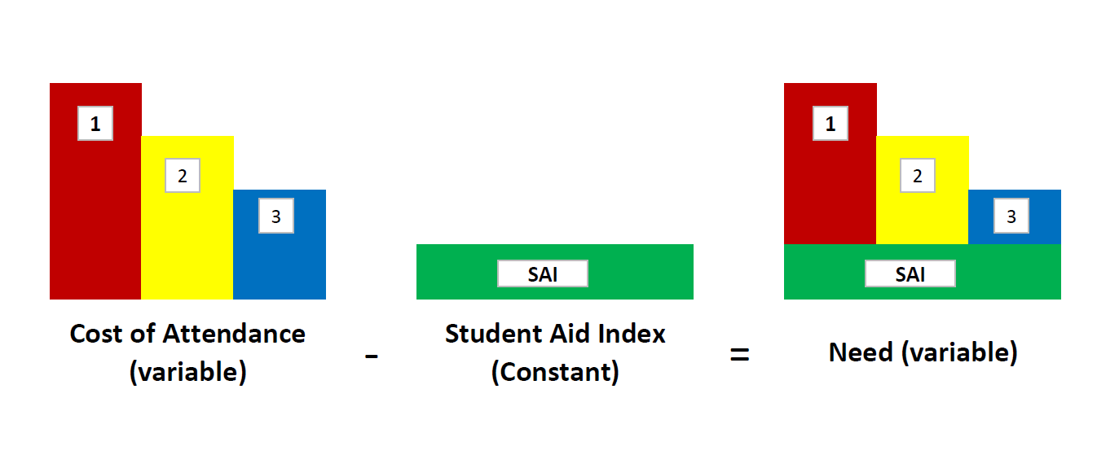
Financial Need

Slide 12
Financial Aid Awarding Philosophy
Need-Based Aid
Awarded up to the student’s need level
Non Need-Based Aid
Awarded up to the difference between the cost of attendance and the offered need-based aid

Slide 13
Need-Based Aid - Grants
Federal Aid
Pell Grant
FSEOG
TEACH
Private & Institutional
State Aid
TAP
NY STEM
Excelsior/Enhanced Tuition

Slide 14
Federal Pell Grant
Pell Grant (23-24 amounts $767 - $7,395)
Entitlement-based aid form
Eligibility for maximum Pell (2024-2025)
Parent not required to file federal tax return
Single parent AGI >0 and ≤225% of NY poverty guideline for family size
Parent is not single with AGI >0 and ≤175% of NY poverty guideline for family size

Slide 15
Federal Pell & SEOG Grants
Eligibility for minimum Pell (2024-2025)
Single parent with AGI ≤325% of NY poverty guideline for family size
Not a single parent with AGI ≤275% of NY poverty guideline for family size
SEOG ($100 - $4,000)
Awarded based on need
Campus-based aid form

Slide 16
TEACH Grants
Up to $4,000 per year (sequestration reduction of 5.7%)
For students who agree to teach in a:
- high-need field
- school that serves students of low-income
Four year service contract, completed within 8 years
More information: https://studentaid.gov

Slide 17
NY State DREAM Act
Provides undocumented and other students access to New York State grants and scholarships
NY High School attendance and completion requirements
Must apply to NYS college within 5 years
Apply at hesc.ny.gov/dream

Slide 18
NY State Tuition Assistance Program
New York resident
Attend New York college or university
Award amount based on need and tuition charges ($500 - $5,665)
Requires separate application

Slide 19
NY Science, Technology, Engineering, & Mathematics Scholarship
New York resident
Attend SUNY or CUNY school
Award amount based on tuition charges minus other state aid (maximum $7,070)
Requires separate application

Slide 20
NY Science, Technology, Engineering, & Mathematics Scholarship
Enrollment in approved program
Must be in top 10% of high school class
5 years employment in NY state in approved field
Service contract required
Can become unsubsidized loan

Slide 21
NY State Excelsior Scholarship and Enhanced Tuition Awards
New York resident
Attend SUNY or CUNY school
Award amount based on tuition charges minus other grants and scholarships (maximum $7,070 / $6,000)
Requires separate application

Slide 22
NY State Excelsior Scholarship and Enhanced Tuition Awards
Must take at least 12 degree-applicable credits each term
Must complete at least 30 degree-applicable credits each year
“Pre-matriculation” credits can be banked for later use

Slide 23
NY State Excelsior Scholarship and Enhanced Tuition Awards
Student must sign residency contract
Student must live in NY for number of years equal to number of years grant received
Employment must be in NY
Total Family AGI = 125,000 or Less

Slide 24
Outside Grants and Scholarships
Available from variety of sources
online searches
high school guidance office
local groups and organizations
employers

Slide 25
Need-Based Aid - Student Employment
Federal Work-Study Program
Awarded as a grant
Allows student to obtain job and work to earn up to the grant amount
Paycheck

Slide 26
Self-Help Aid - Federal Loans
Stafford Loans (Direct)
Need or Non-Need Based
Parents (PLUS) Loans (Direct)
Non Need-Based

Slide 27
Federal Direct Student Loans
Subsidized or Unsubsidized
5.50% fixed interest rate (UG - 2023-2024)
6 month repayment grace period
Repayment period from 10 - 30 years
One-time Origination Fee of 1.057%

Slide 28
Federal Direct Student Loans
Maximum Amounts:
1st Year: $5,500 ($3,500 max. subsidized)
2nd Year: $6,500 ($4,500 max. subsidized)
3rd Year: $7,500 ($5,500 max. subsidized)
4th Year: $7,500 ($5,500 max. subsidized)

Slide 29
Federal Loans - PLUS
Parents Loan for Undergraduate Students
Fixed interest rate: 8.05% (2023-2024)
One-time origination fee of 4.228%

Slide 30
Federal Loans - PLUS
Repayment begins 60 days after loan is fully disbursed
Maximum annual amount equal to cost of attendance minus all other aid
Dependent on credit!!! (No adverse credit)

Slide 31
Applying for Financial Aid
FAFSA (Free Application for Federal Student Aid)
ETA (Express Tap Application)
Supplemental & institutional applications

Slide 32
FAFSA
Main federal aid application
Available in online and paper formats
Collects income, asset, and household size information
Apply as soon as possible once available (December)
Use 2022 Tax Return (2024-2025 Year)

Slide 33
What You Report – Student and Parent(s)
Income and Taxes Paid
Child Support (paid or received)
Non-Retirement Investments
Cash, Savings, Checking
Business/Real Estate Net Worth
Number in Household and College
Resident Farm

Slide 34
What You Don’t Report
Retirement Investments
Value of Home or Amount of Mortgage
Value of Car
Debt

Slide 35
Who Counts as a Parent
Biological Parents Living Together
Divorced/Separated:
Biological parent who provides most support
That parent’s new spouse, if remarried
Adoptive Parent(s)

Slide 36
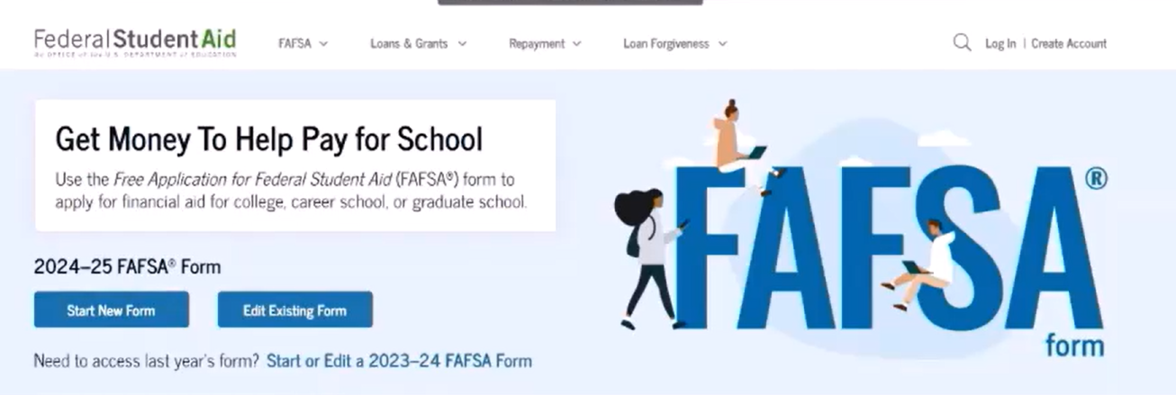
FAFSA - https://studentaid.gov

Slide 37
FSA ID – https://studentaid.gov/fsa-id
Parent and student should each get an ID
What you will need:
Parent SSN
Parent cell # or e-mail address
Student SSN
Student cell # or e-mail address

Slide 38
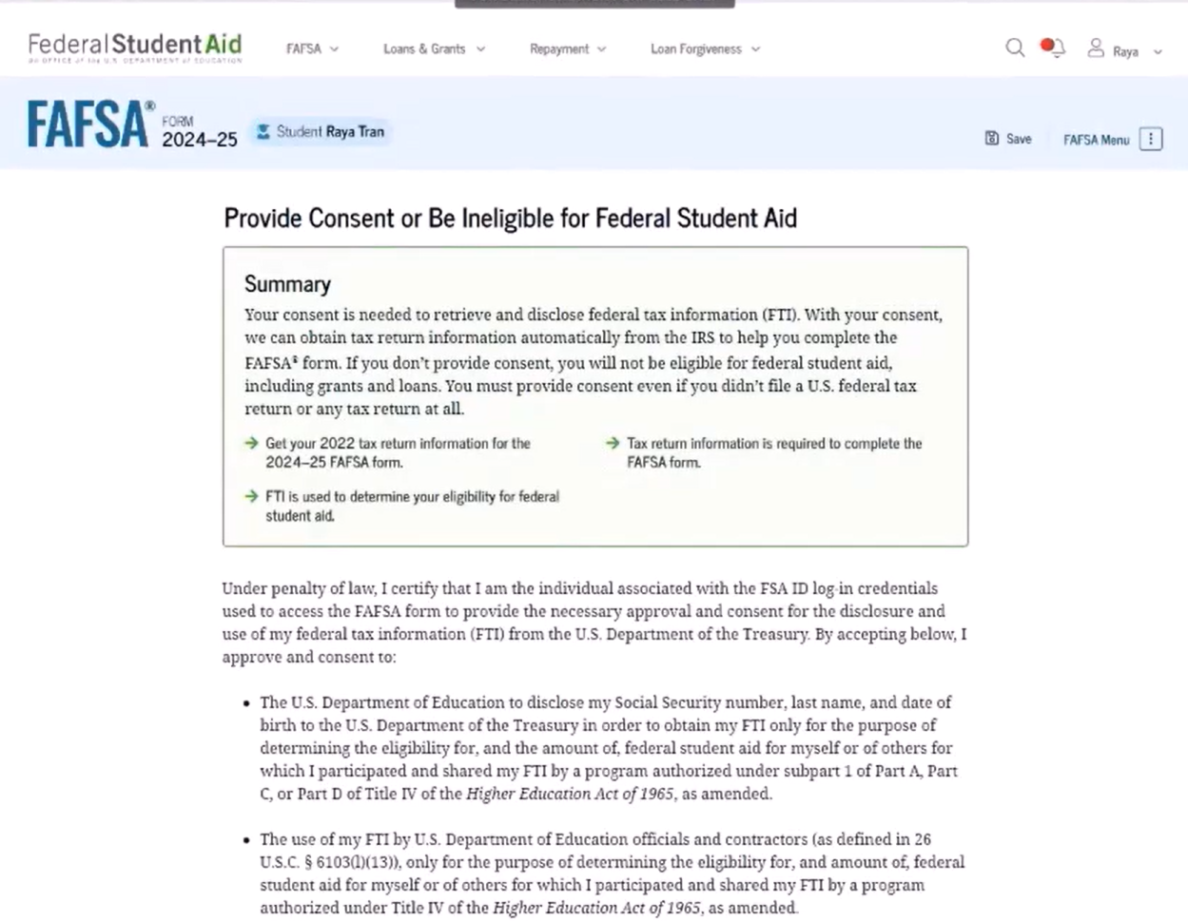
Provide Consent
Student and parent(s) must provide consent
If tax filing status is married filing jointly, only one parent needs to provide consent

Slide 39
Inviting Parent(s)
The student enters parent information to invite them to complete parent sections.

Slide 40
Reporting Income
The 2024-2025 FAFSA will look at 2022 income.

Slide 41
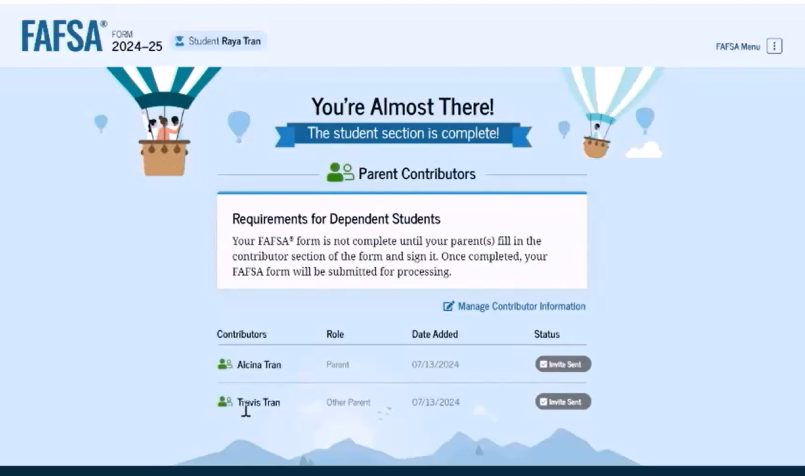
Submitting the FAFSA

Slide 42
Prior–Prior Year Data (PPY)
FAFSA and other applications completed with tax info from PPY
Don’t forget to use 2022 tax information for 2024-2025 (school year) FAFSA
Asset and household info from current year!
Child support is reported for the last complete calendar year

Slide 43
New York State Applications
www.hesc.com or www.tapweb.org/totw
Application for NY State Grant Program
Complete with FAFSA
EXCELSIOR, DREAM, STEM all require separate applications

Slide 44
Supplemental & Institutional Applications
Check with each school for additional requirements
CSS Profile (College Board)
https://cssprofile.org
Unique institutional applications

Slide 45
Application Processing
FAFSA and TAP results sent to student and all listed colleges
Colleges create and provide aid packages

Slide 46
Financial Aid Award Letters

Slide 47
Award Letters

Slide 48
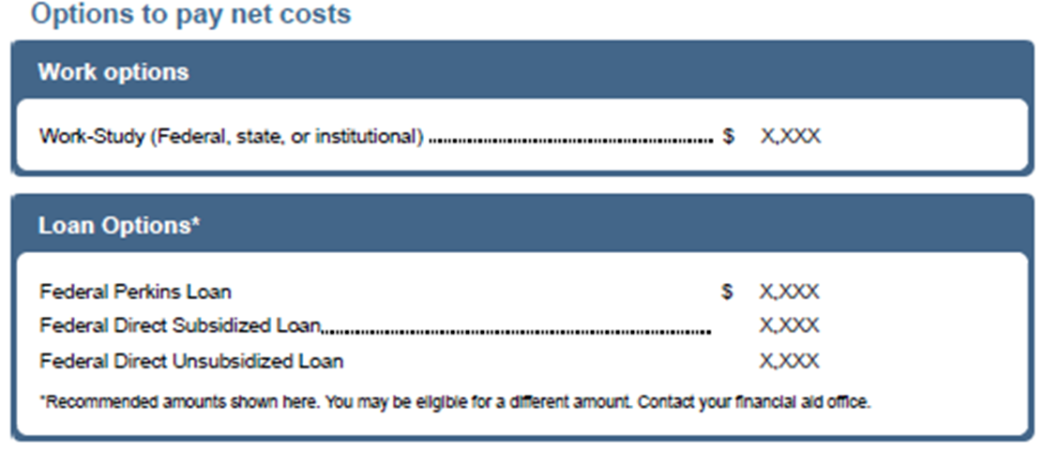
Award Letters

Slide 49
Frequent Application Issues
Social Security Numbers
Divorced/remarried parental information
Untaxed income
U.S. income tax paid

Slide 50
Frequent Application Issues
Household size
Number of household members in college
Real estate and investment net worth
Dependency Status

Slide 51
Special Circumstances
Cannot report on FAFSA
Send explanation to financial aid office at each college
College will review special circumstances
Request additional documentation
Decisions are final and cannot be appealed to U.S. Department of Education

Slide 52
Special Circumstances
Change in employment status
Medical expenses not covered by insurance
Change in parent marital status
Unusual dependent care expenses

Slide 53
What Does It All Mean? Things to Consider
Compare bottom line cost
Compare gift aid/self-help aid ratio
Consider amount of work-study award
Review scholarship and grant criteria
Investigate outside/private funding

Slide 54
Thank you!
Cathy Hill
Assistant Director of Financial Aid
finaidt3@syr.edu

