Slide 1
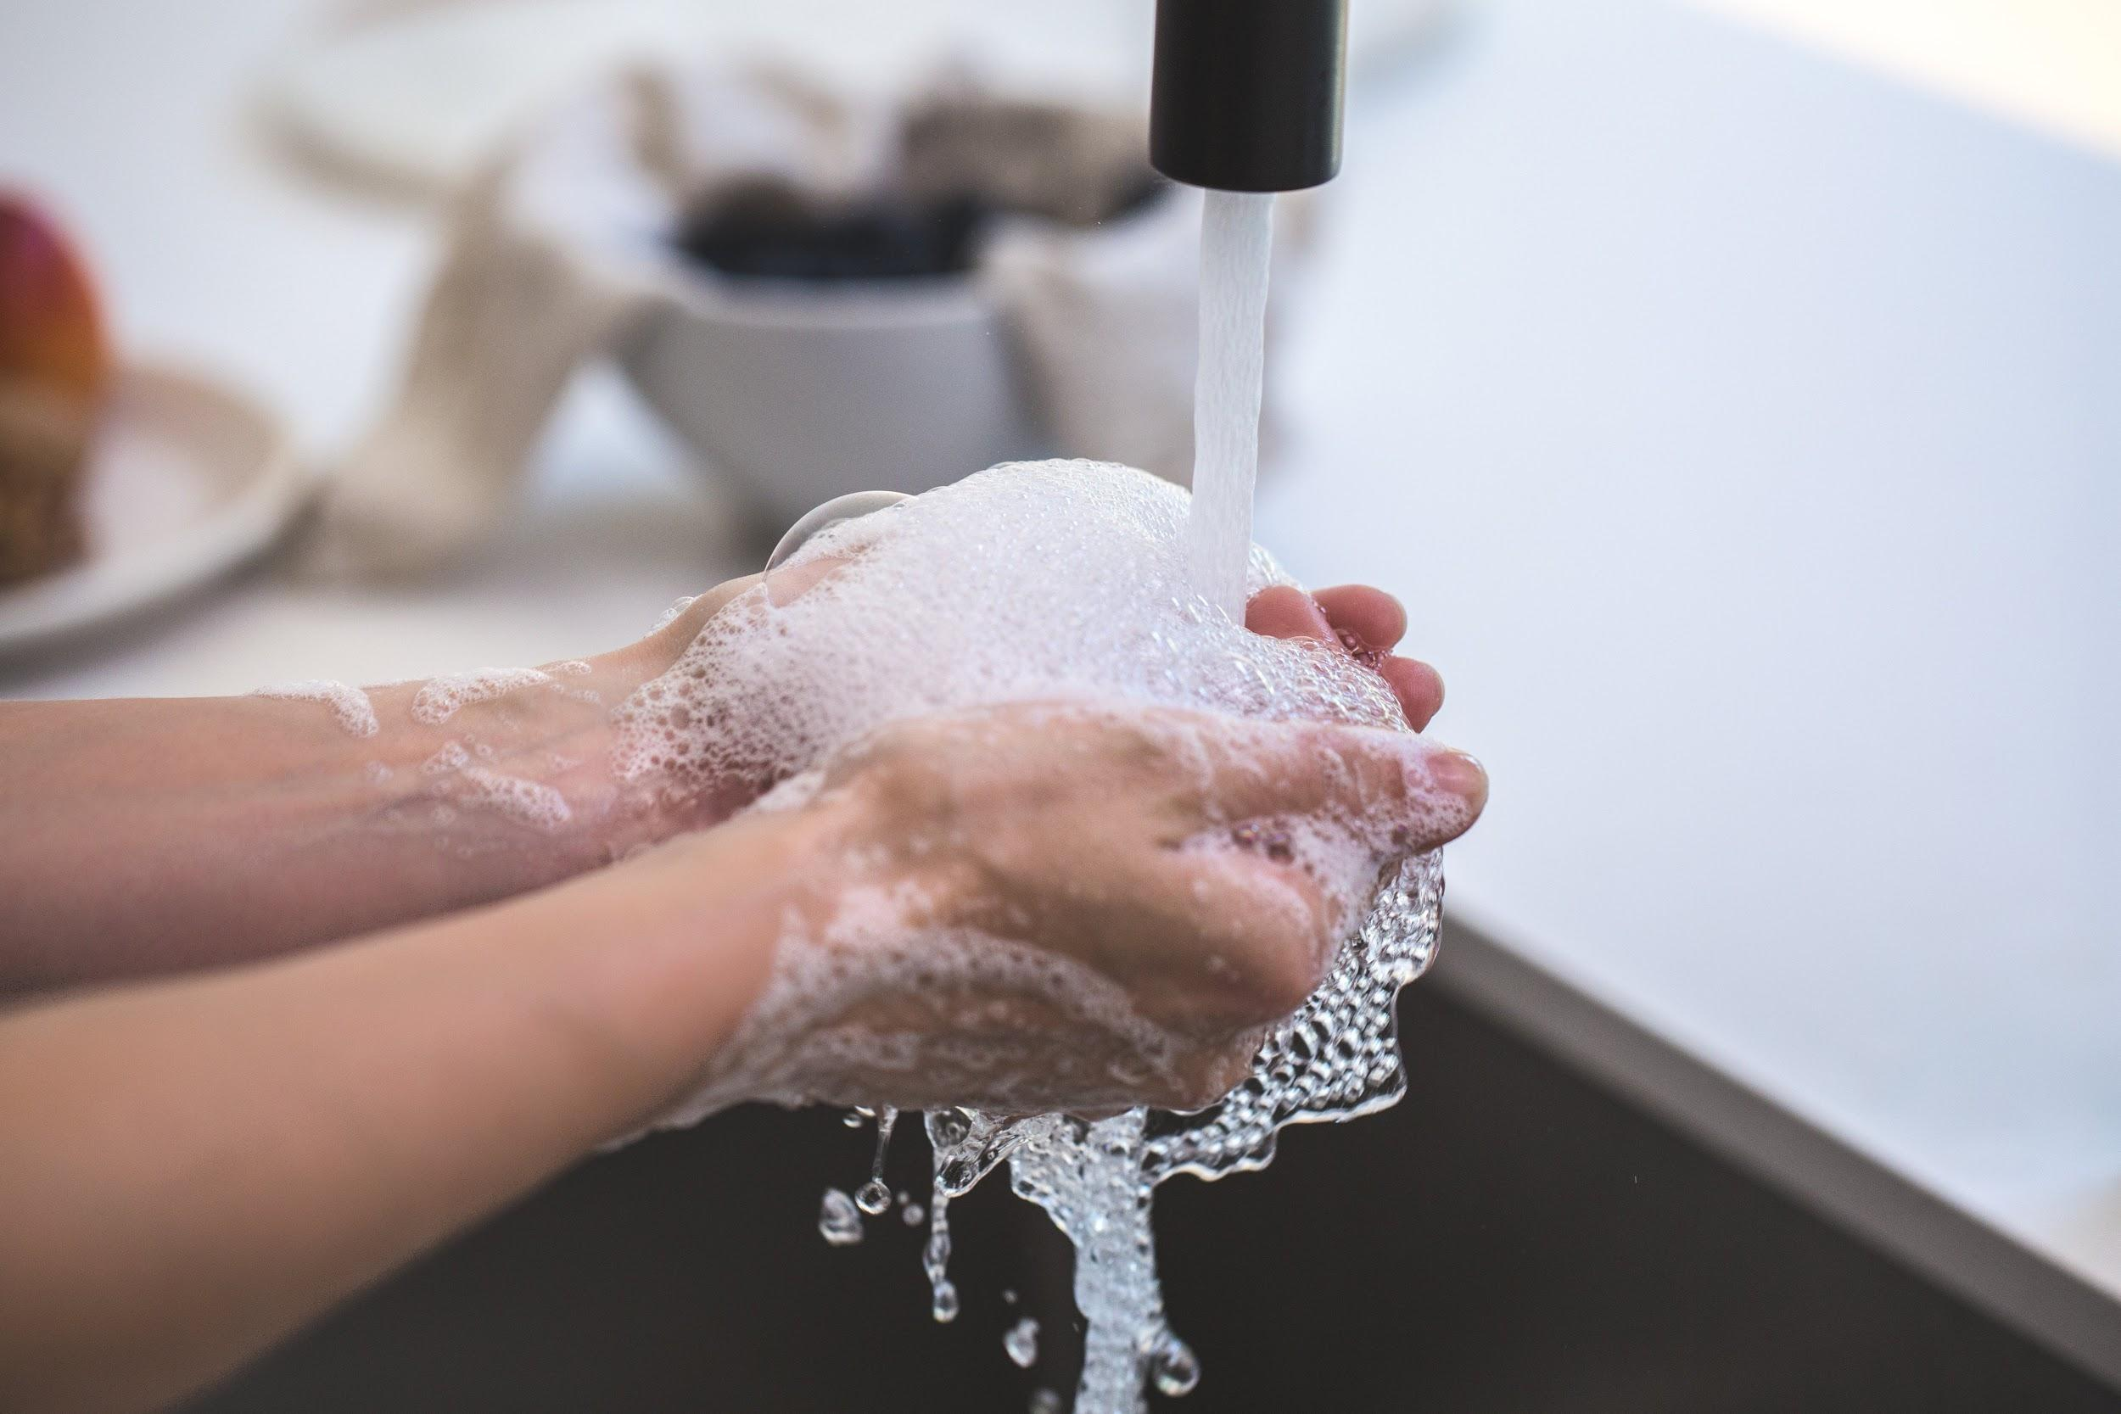
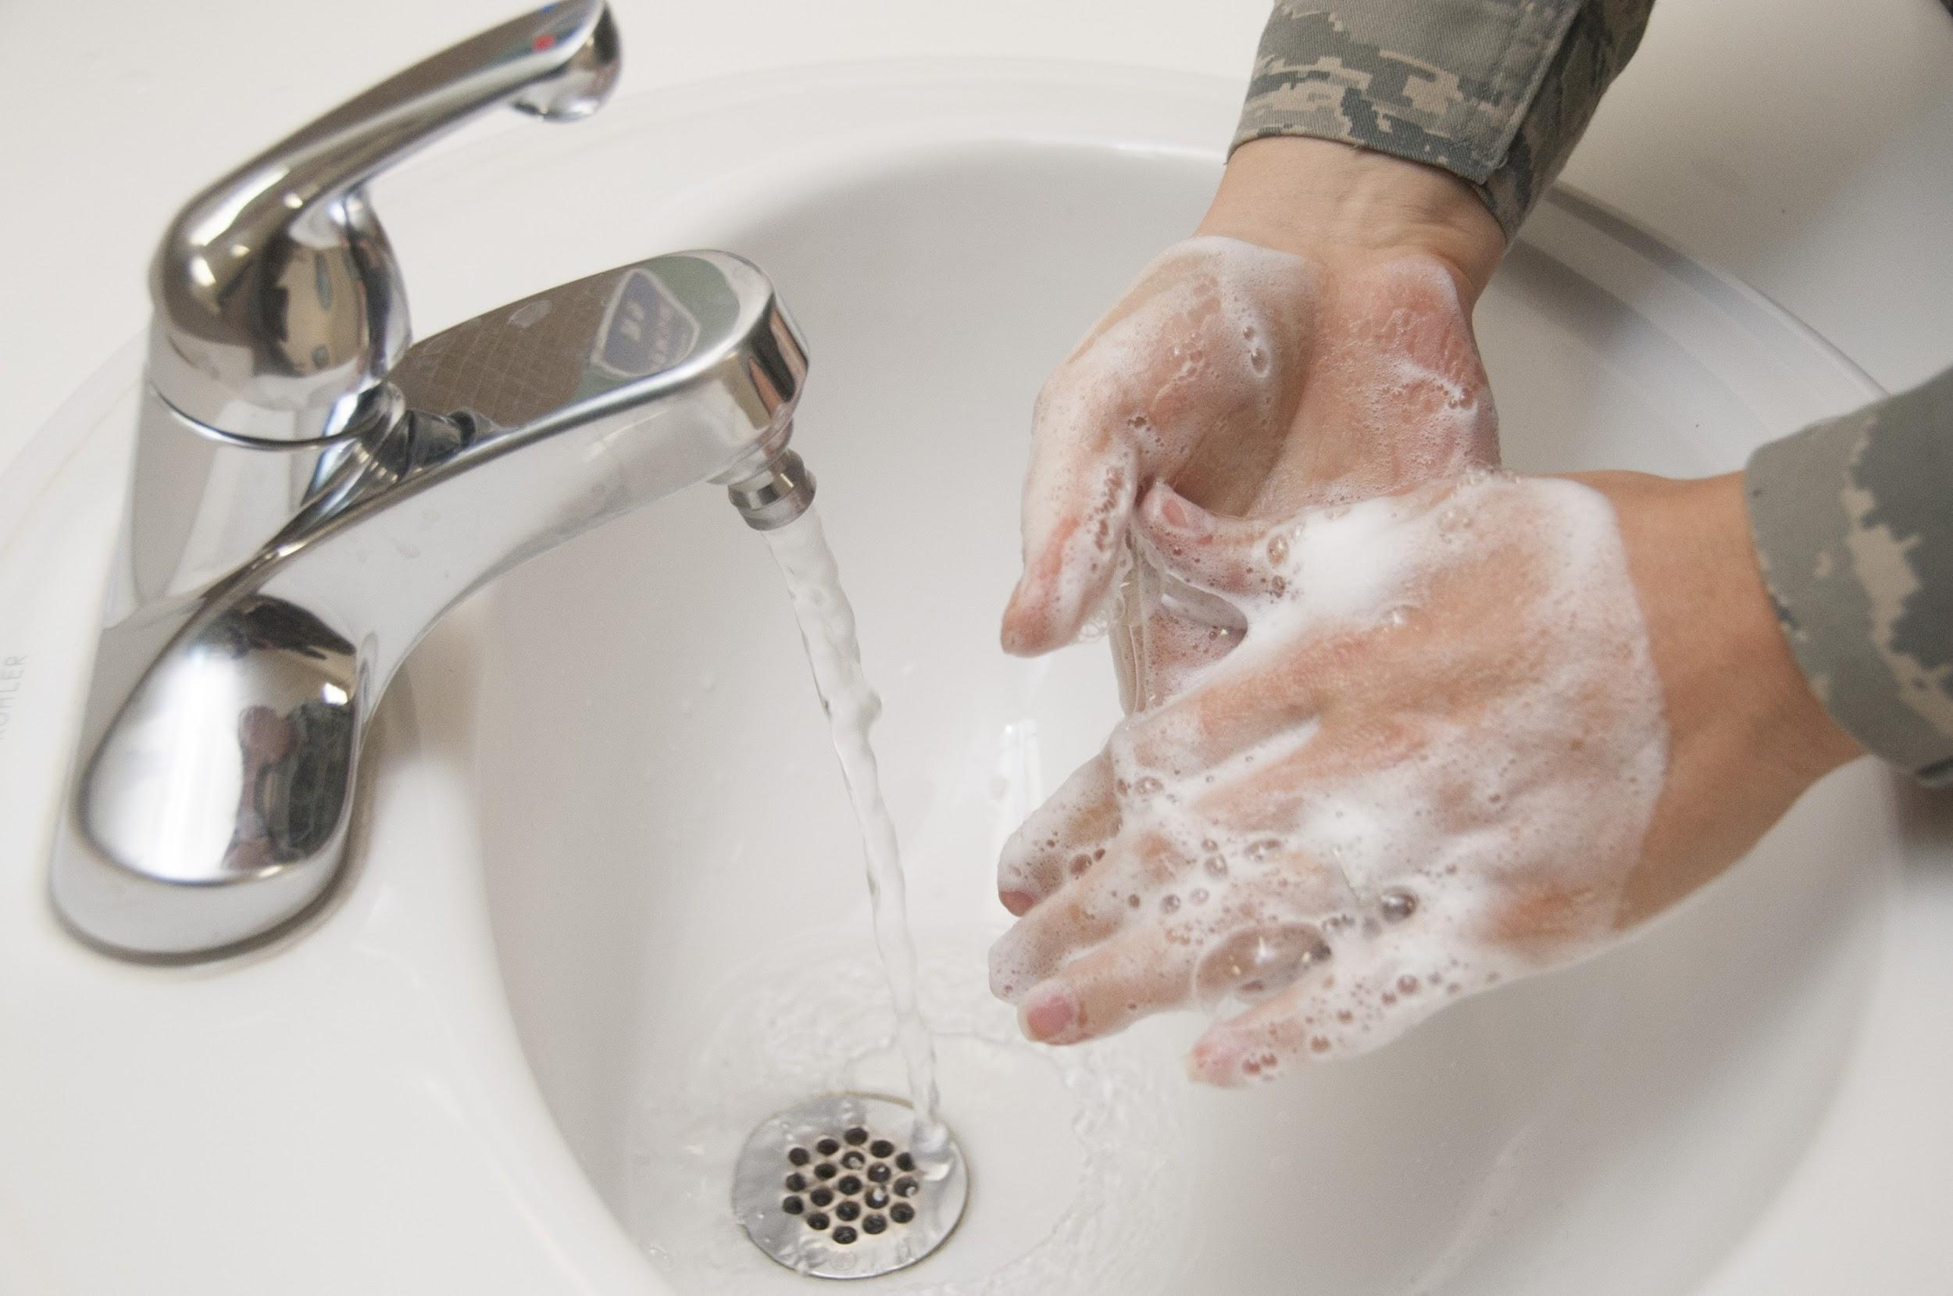
Seven Days of Playground Safety
Always wear a mask on the playground. Keep 6 feet apart and wash your hands before and after being on the playground.

Slide 2
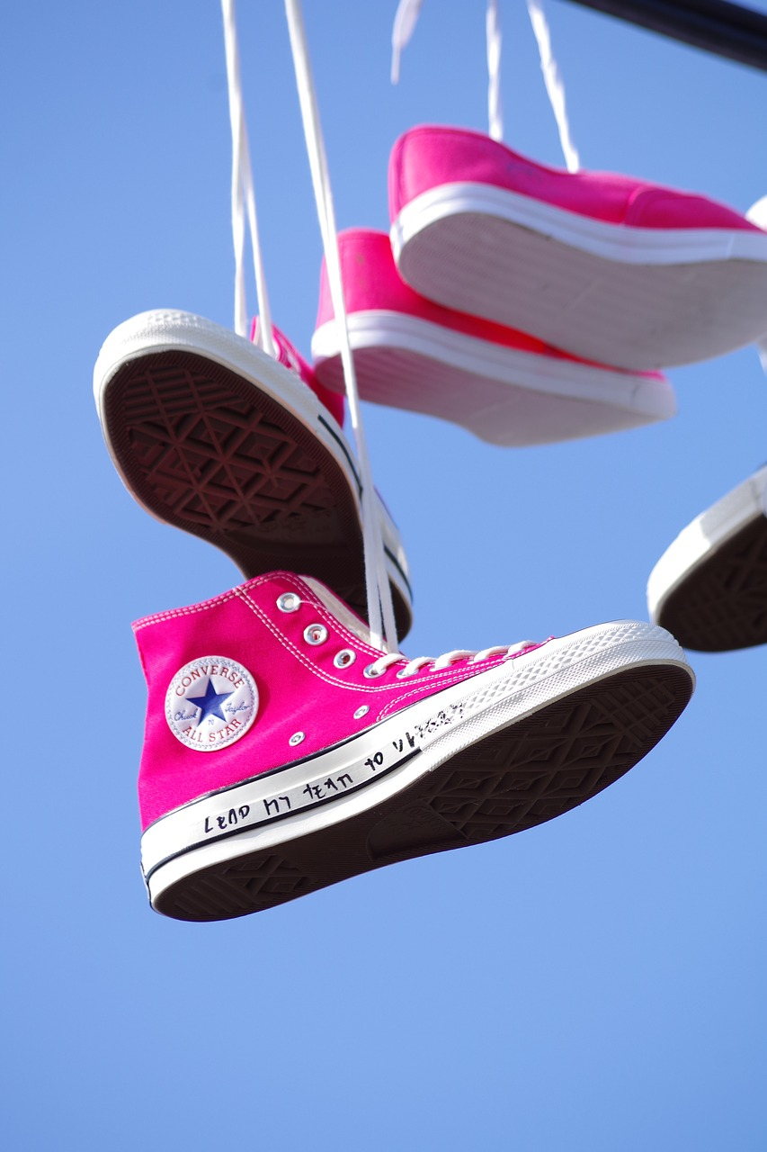
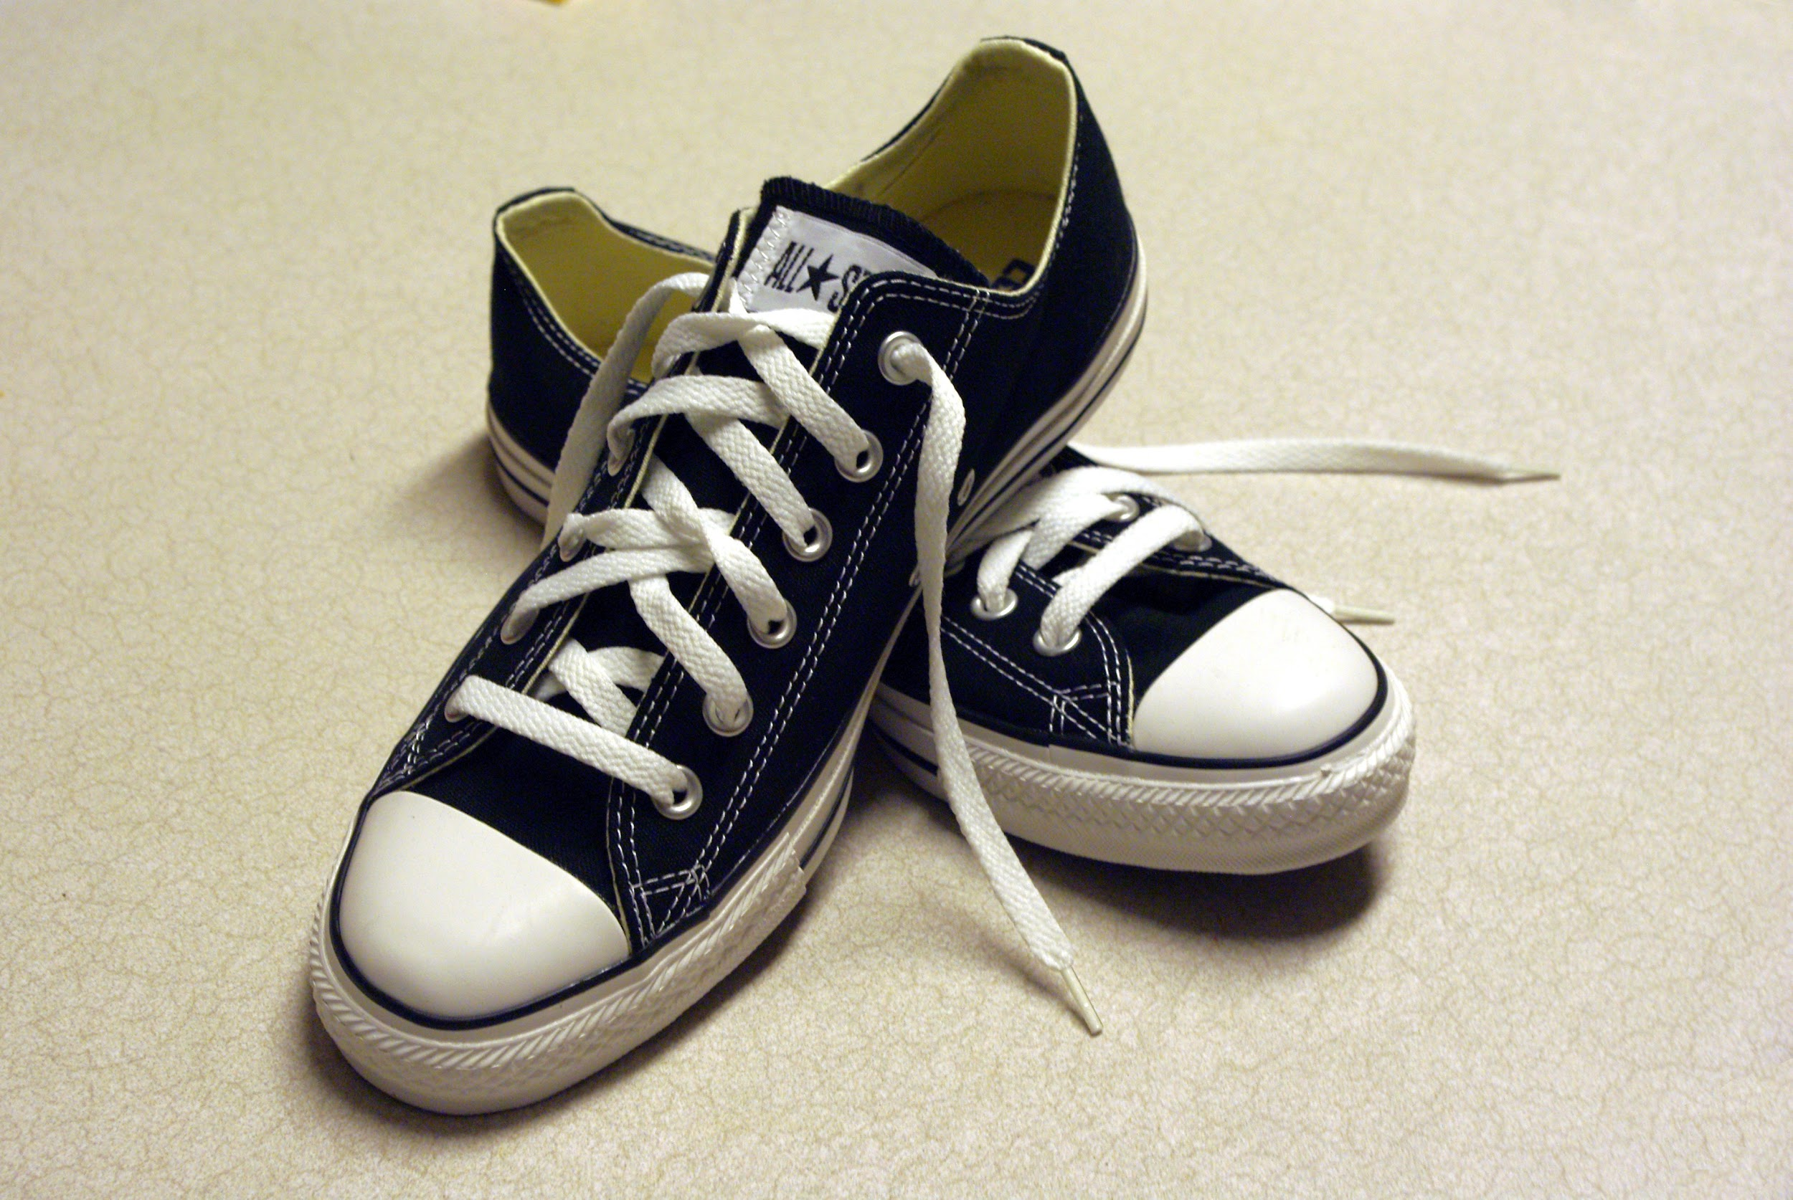
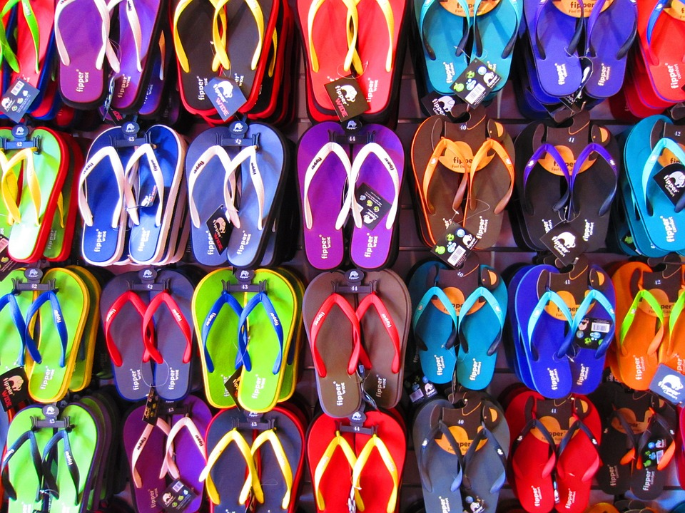
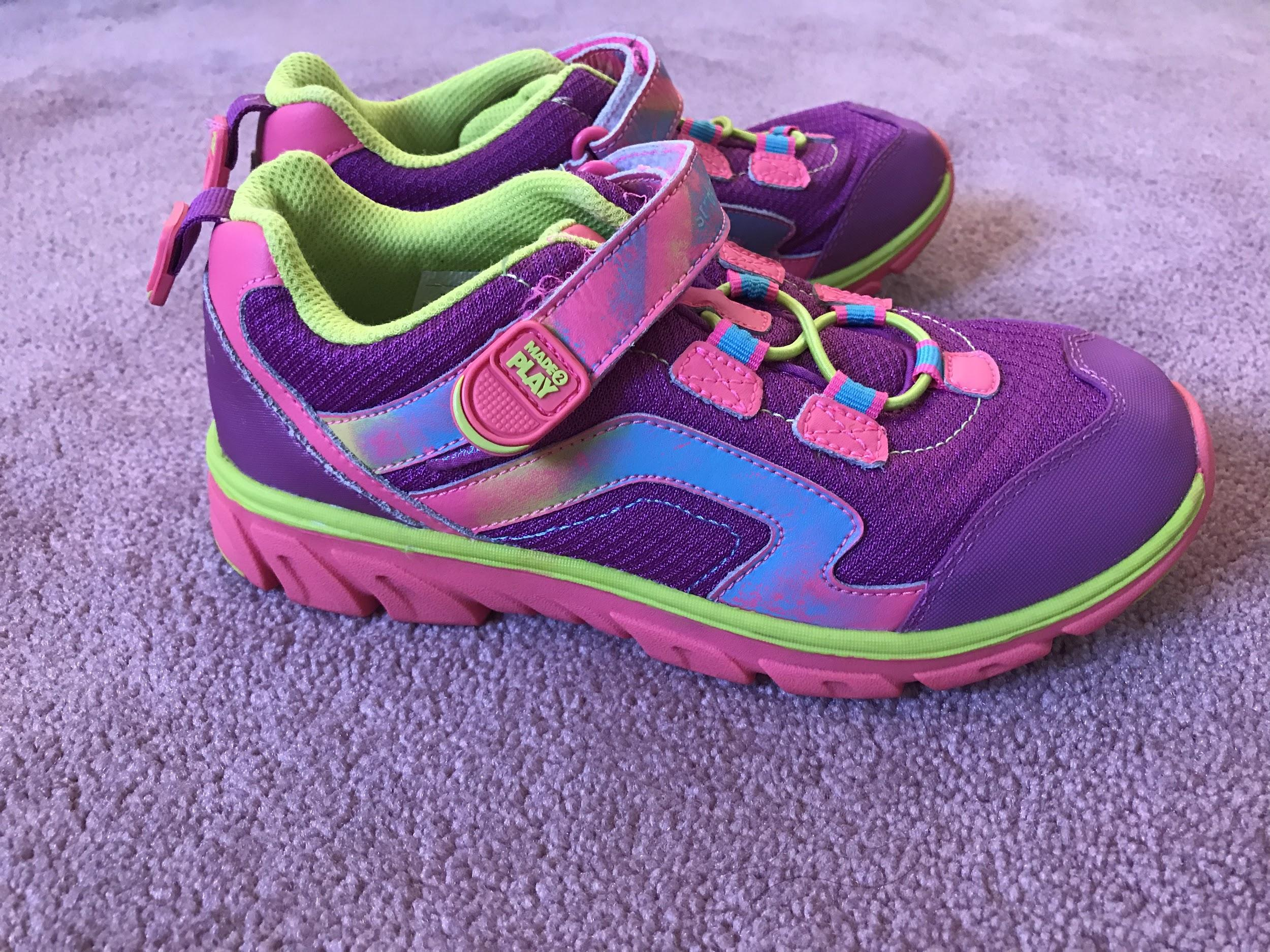
Playground Safety
Always wear your sneakers or closed toe shoes. Flip flops and sandals are not allowed on the playground. You can always keep a pair of sneakers in your backpack.

Slide 3
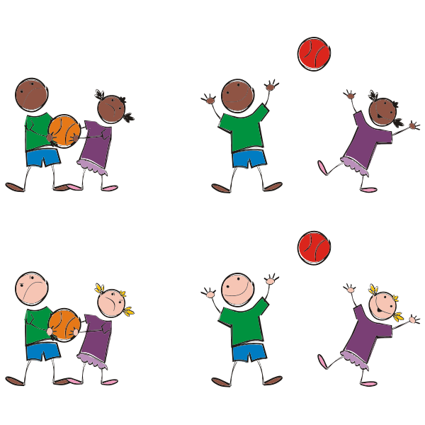
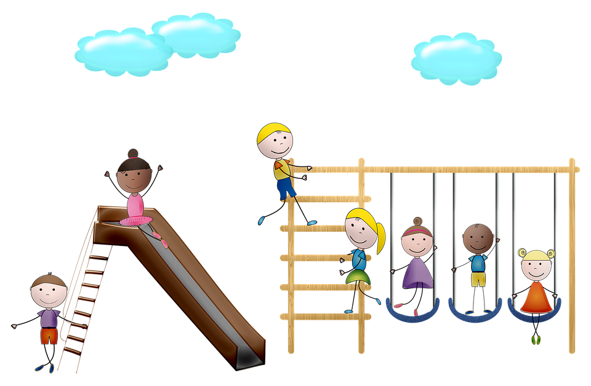
Playground Safety
Always be safe and responsible on the playground. Never push or play rough, especially on the slides, swings or other equipment.

Slide 4
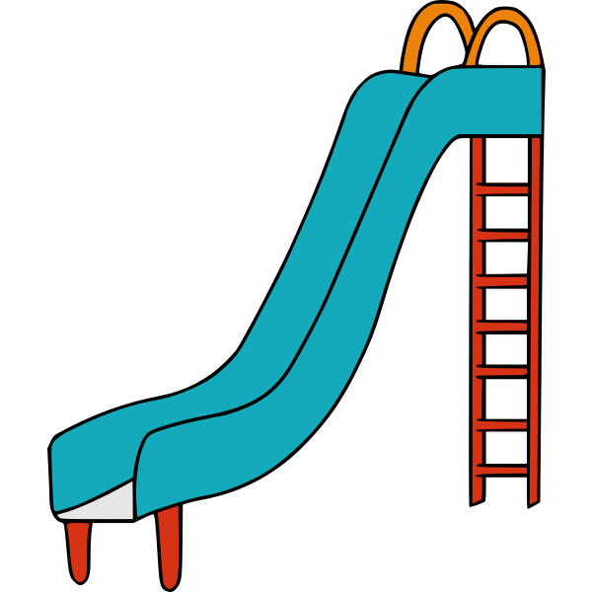
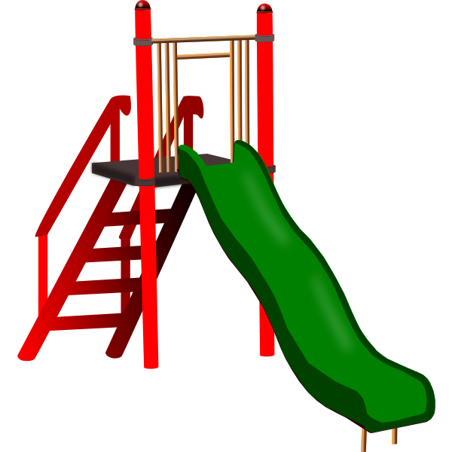
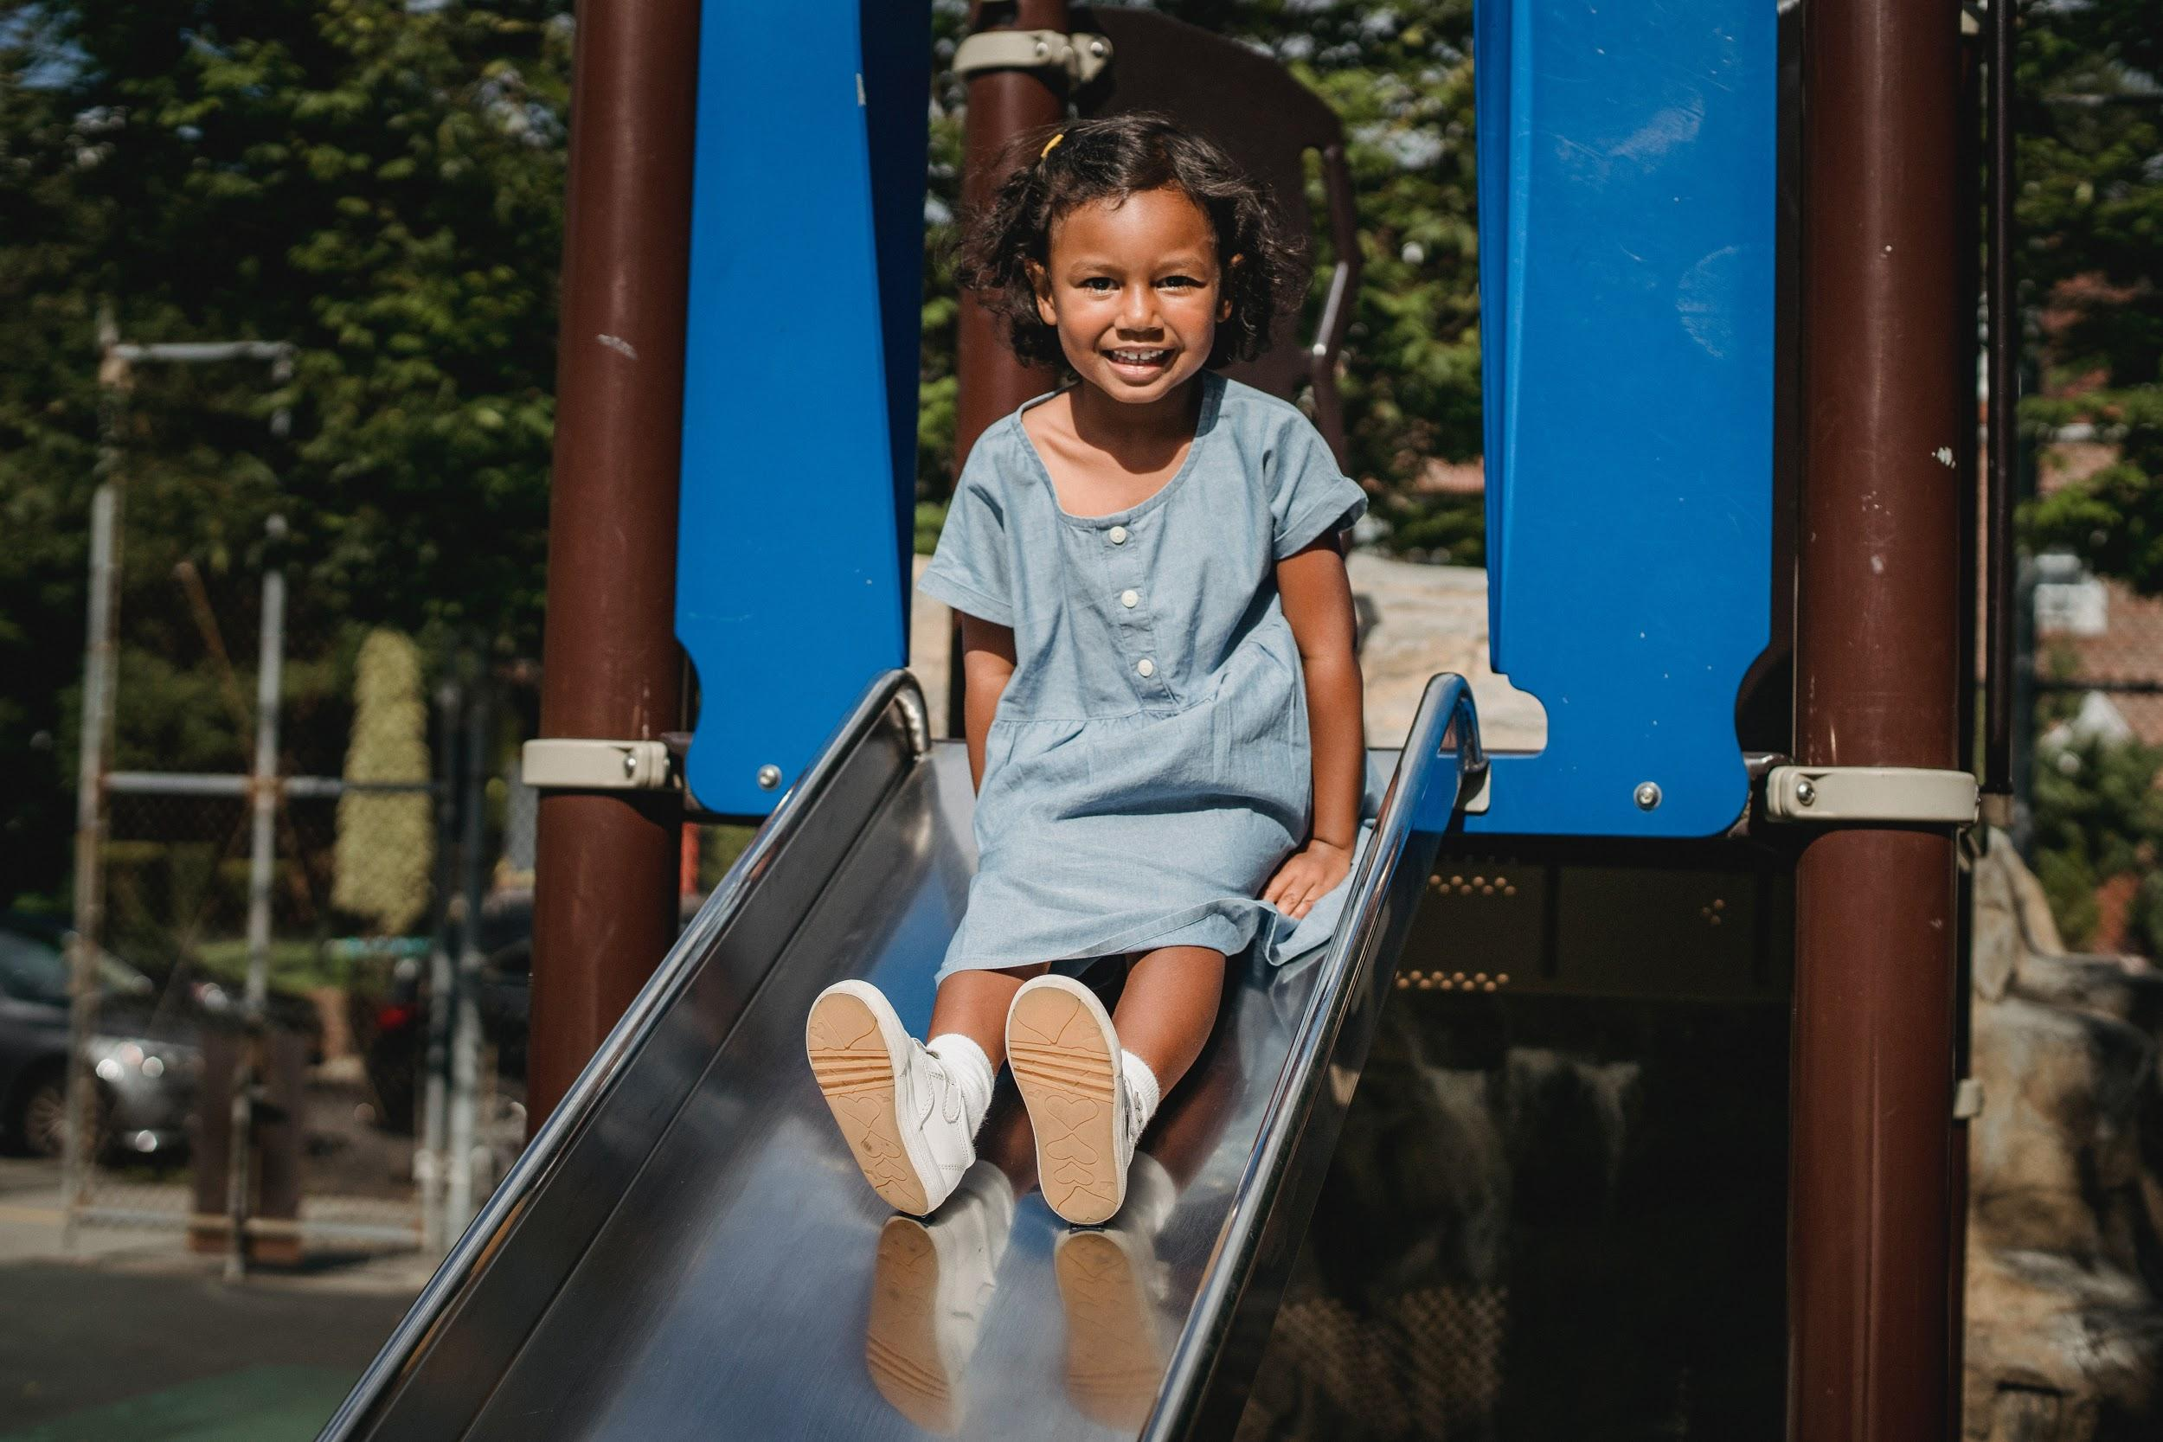
Playground Safety
Use equipment properly. Do not climb UP the slides, always go DOWN the slides on your bottom, feet first. Never stand on the slides or swings.

Slide 5
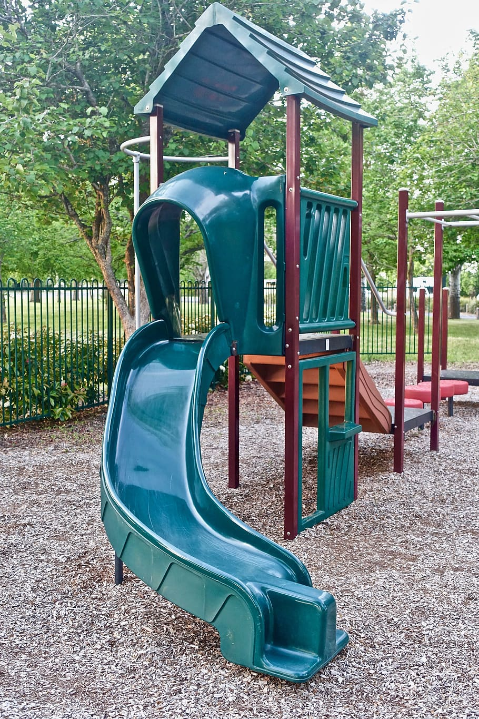
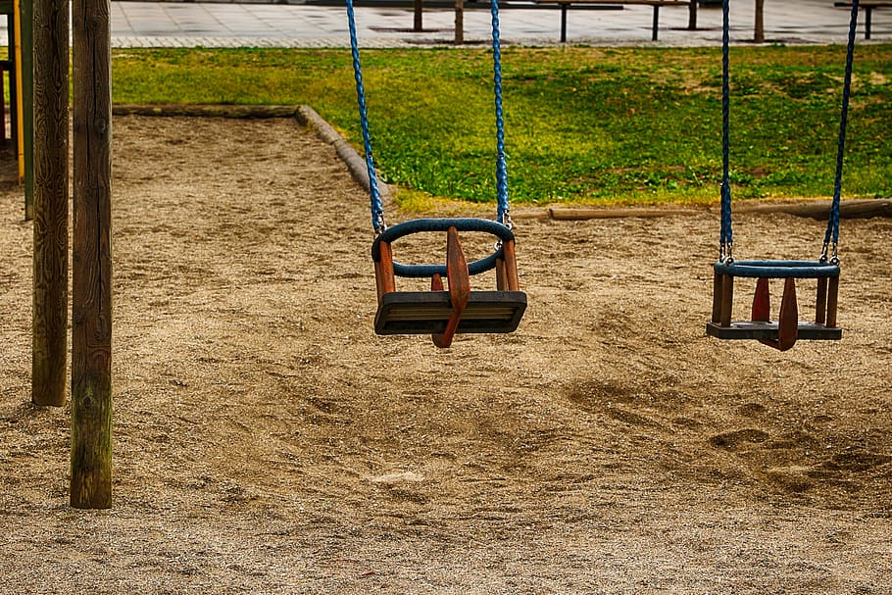
Playground Safety
Always WALK in the wood chips around the playground equipment. Keep safety in mind

Slide 6
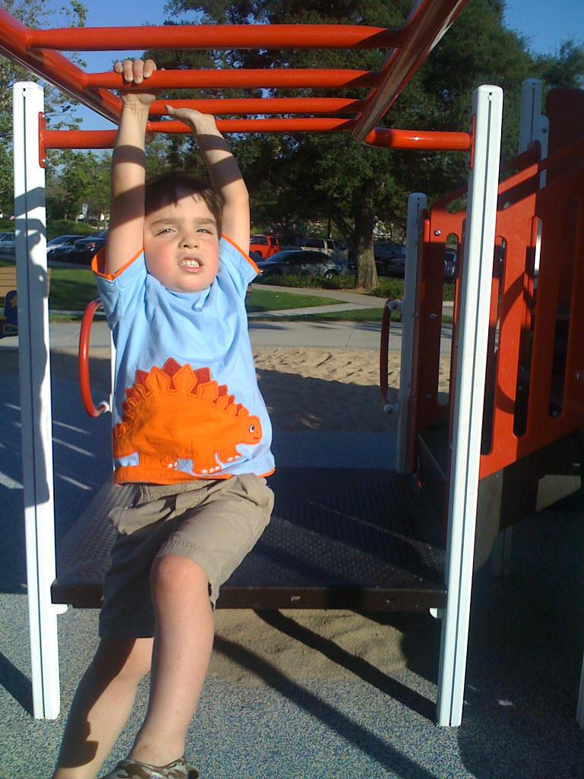
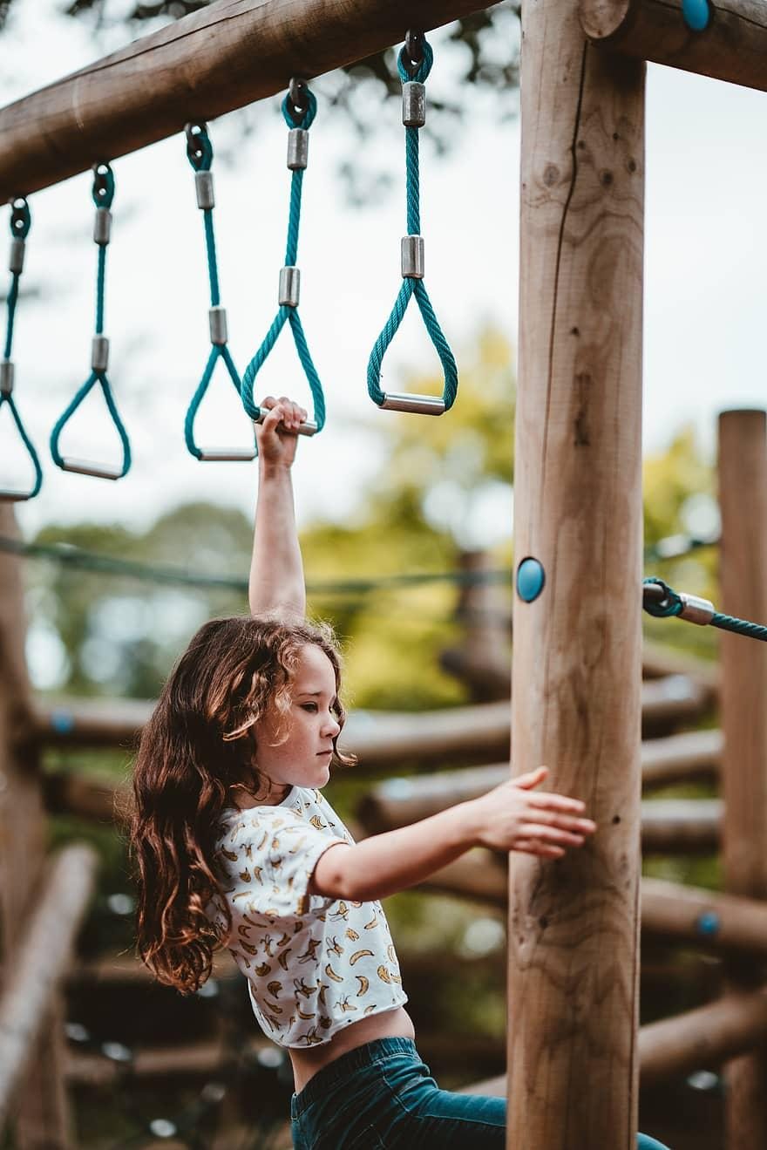
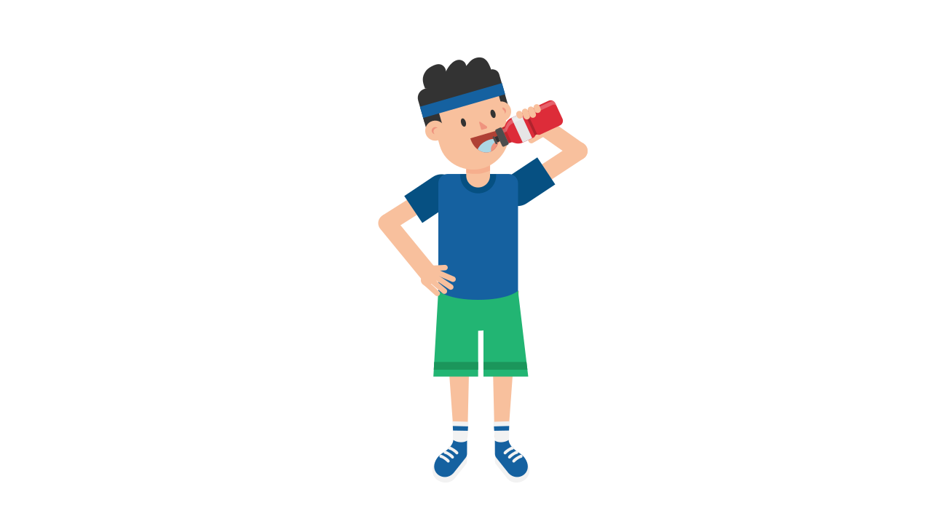
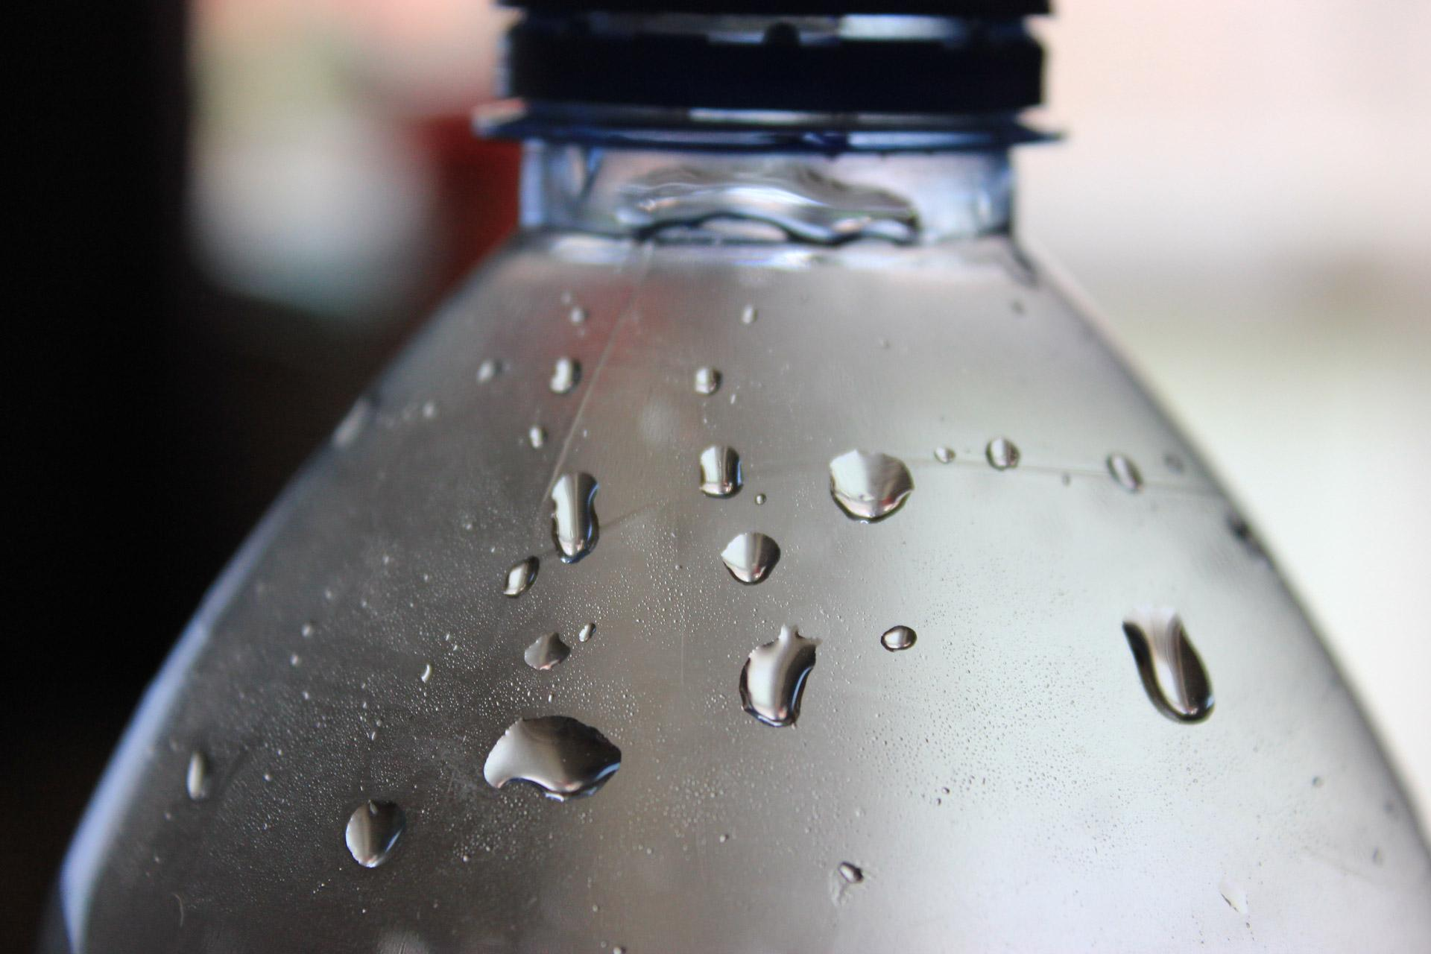
Playground Safety
On hot days, always be careful on the monkey bars and other climbing areas; they can be hot. Also, drink plenty of water to keep your body healthy and hydrated.

Slide 7
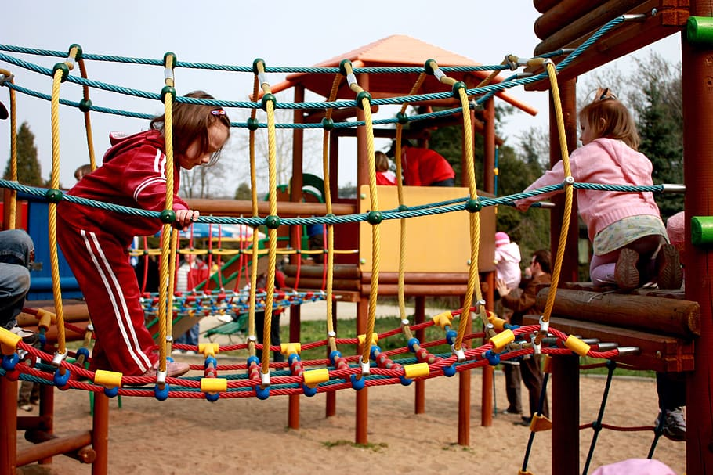
Playground Safety
When climbing down from the monkey bars and other high areas, make sure no other kids are in the way. Always try to land on both feet with your knees bent.

Slide 8
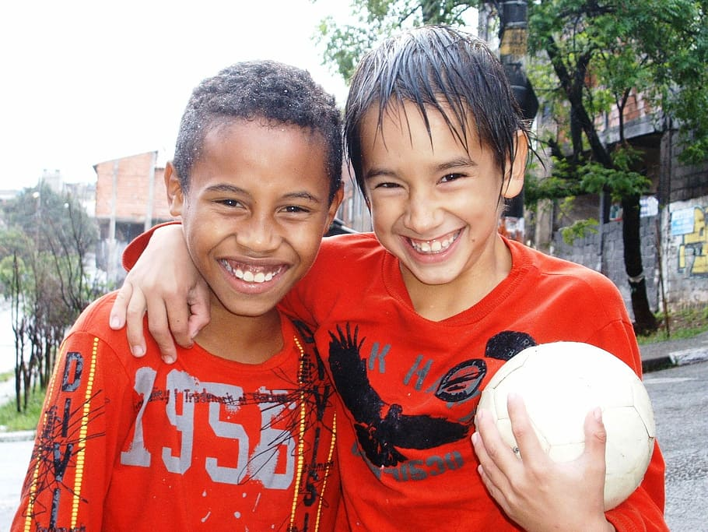
Playground Safety
Always be kind, take turns and treat others like you would want to be treated. Invite friends to play with you and always remember the Allen Road Promise

