Slide 1
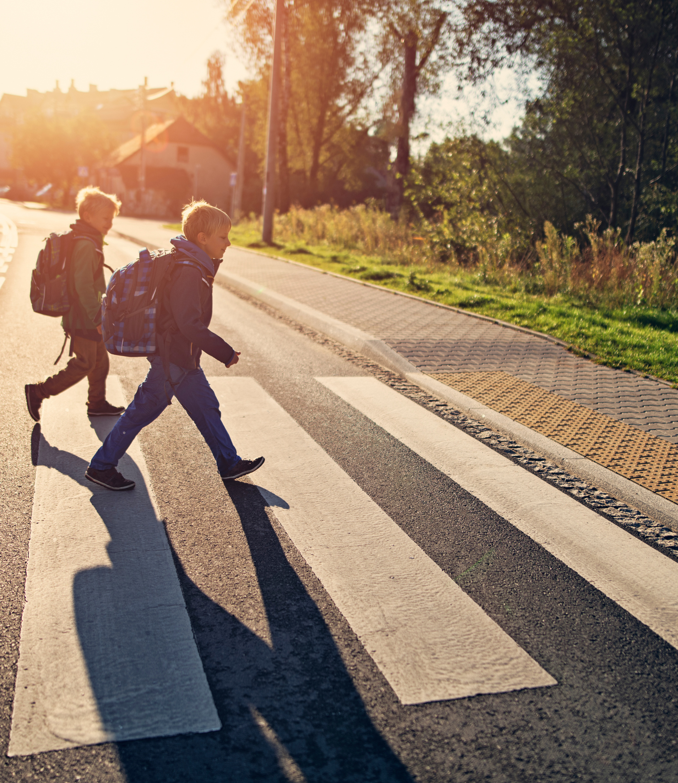



END OF DAY
WALKERS
Cross at the Crosswalk
Enter & Exit at the side door in the front of the building
A parent, sitter, or guardian must be present to dismiss
VEHICLE PICK UP
See Next Slide

Slide 2
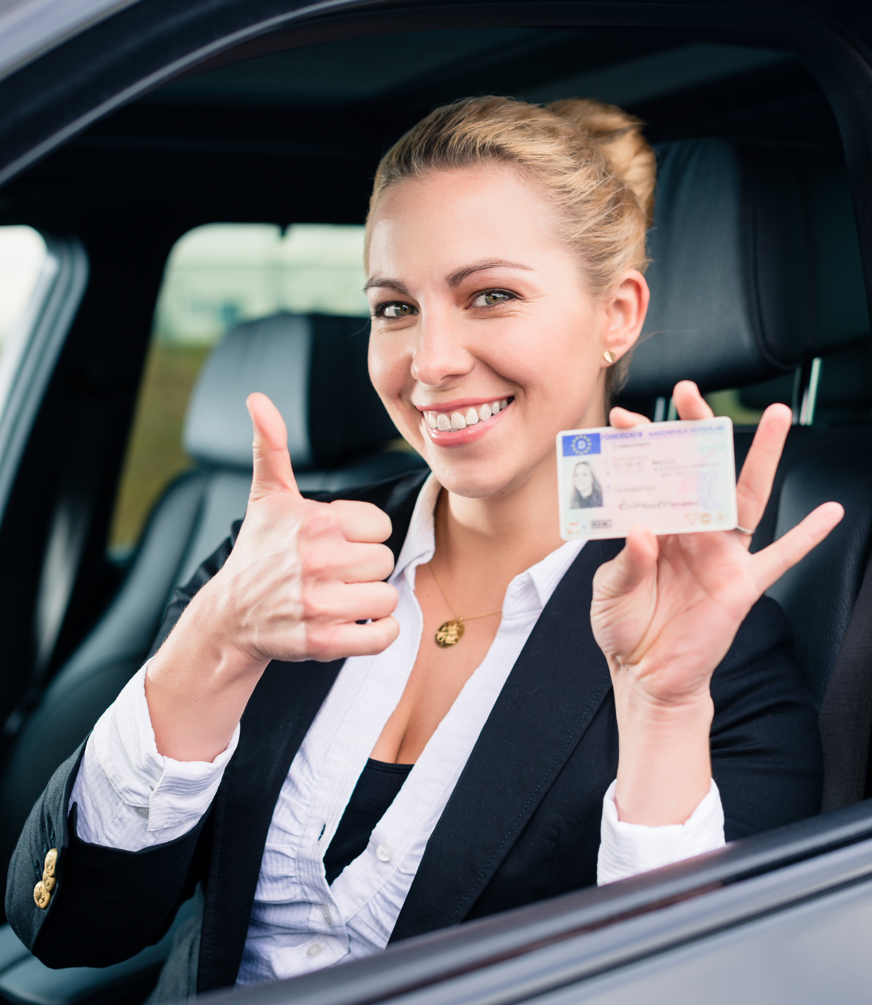
END OF DAY
PICK-UP
Send a Note
Have ID Ready
Make sure whoever is picking up is listed as a designated pick-up person with the school
EVERYDAY PICK UP
See Next Slide

Slide 3
EVERY DAY
PICK-UP
Notify School Ahead of Time
Have ID Ready
(until you get your window card)
Please Follow Directions
DIRECTIONS
See Next Slide

Slide 4
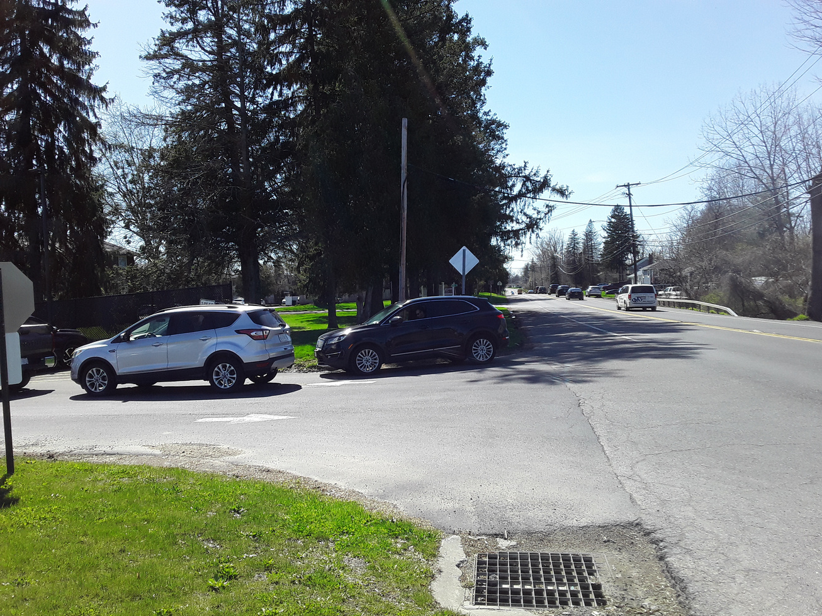

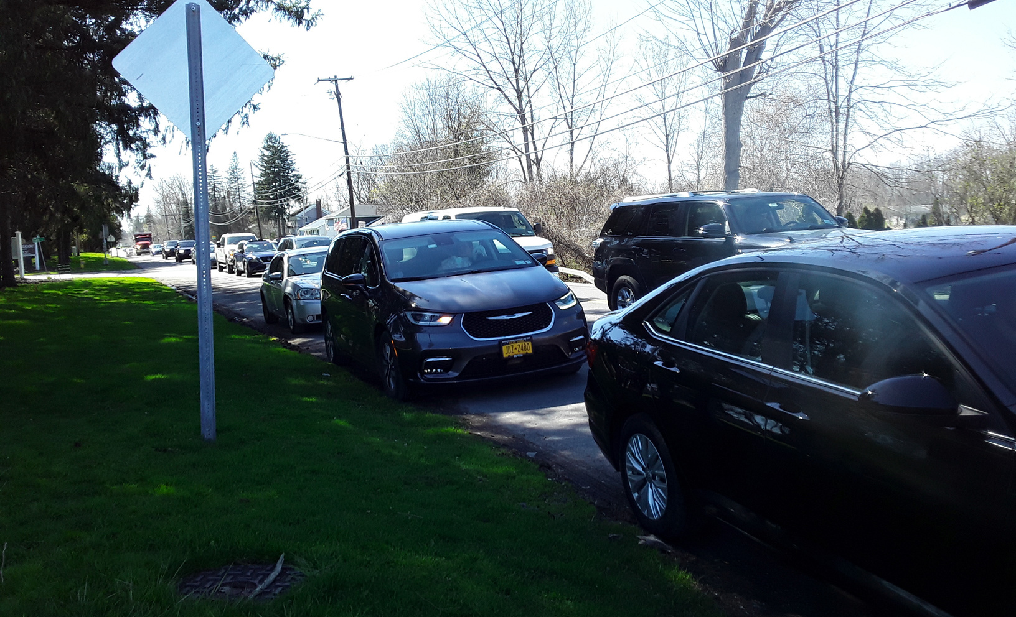
DIRECTIONS
1st
If cars are already at the end of the driveway, DON’T PULL IN
Go to the apartments next door, turn around and join the line - single file down side of Bear Road and Apartment Driveway
BE RESPECTFUL & COURTEOUS
They are allowing us to invade their space!

Slide 5
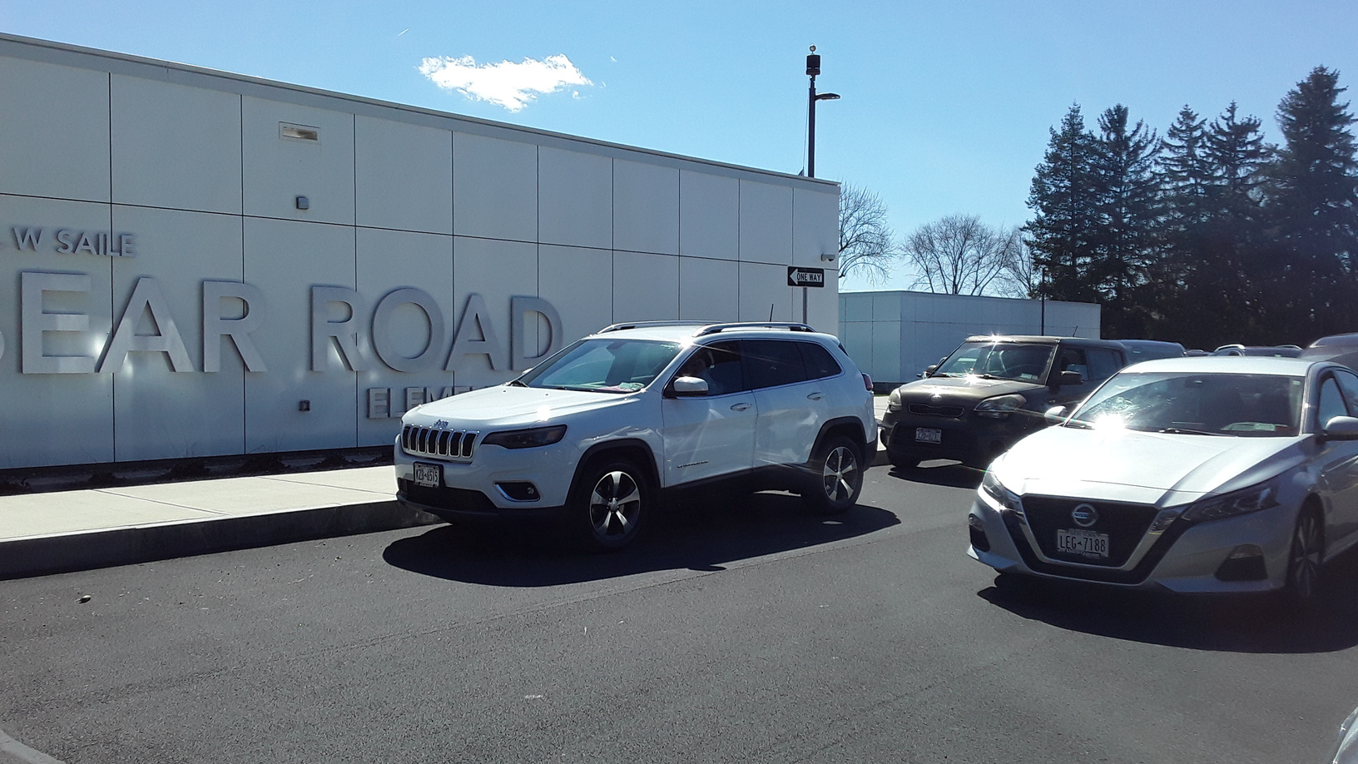
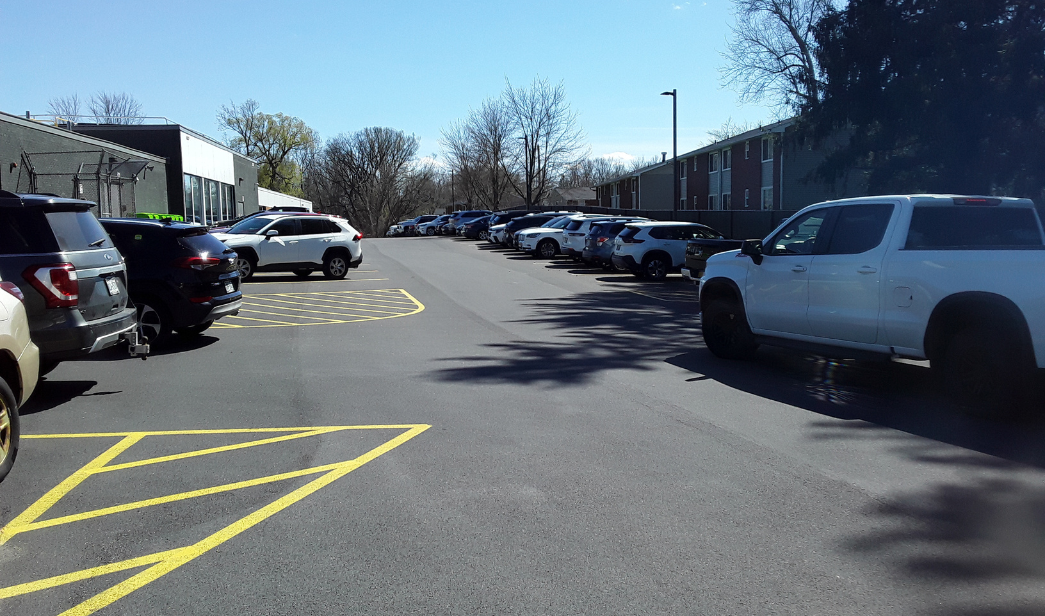
DIRECTIONS
2nd
Form 2 lines in front of the school
When the 2 lines get to the end of the row of parked cars, form a single file line along the end
DO NOT BLOCK THE EXIT
from the back parking lot!
BE RESPECTFUL & COURTEOUS

Slide 6
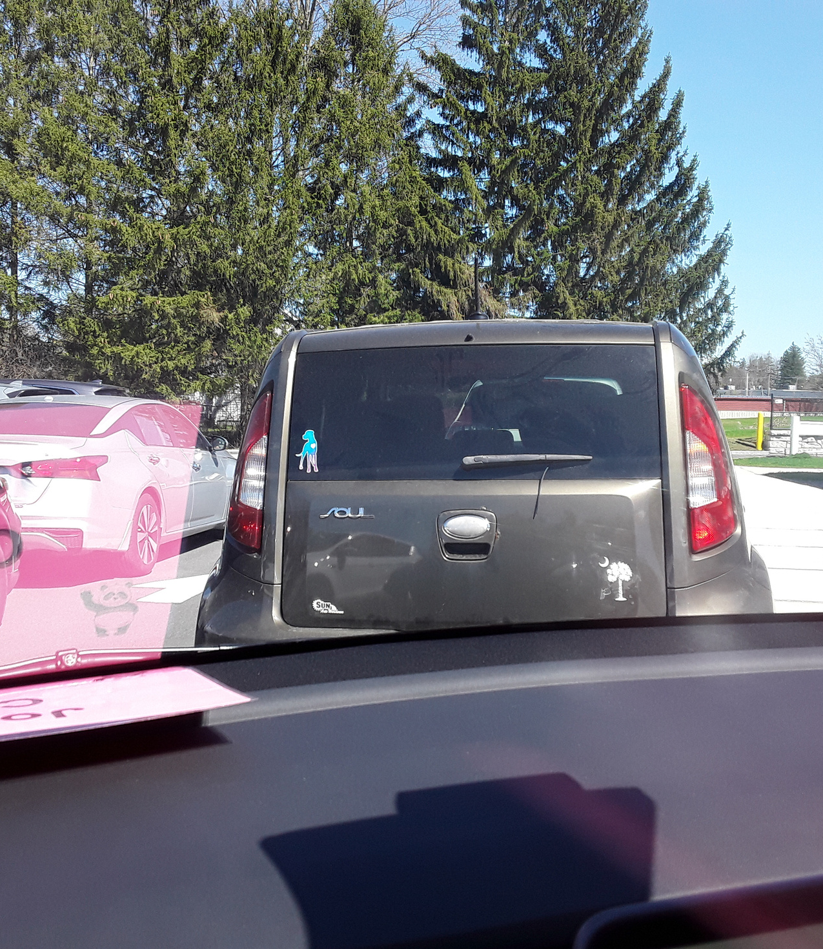
DIRECTIONS
3rd
Know where the front of your car is in relation to the car in front of you
Pull up close to the car in front of you
You DO NOT need to leave the crosswalks open
while in the pick up line
BE RESPECTFUL & COURTEOUS

Slide 7
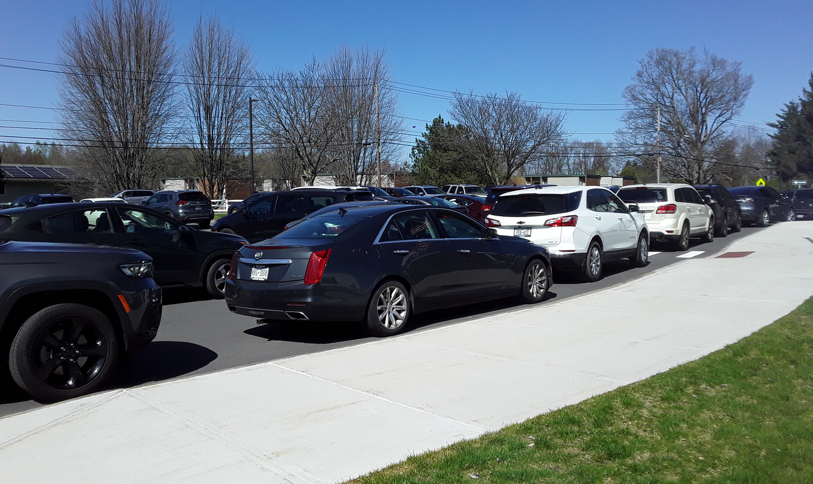
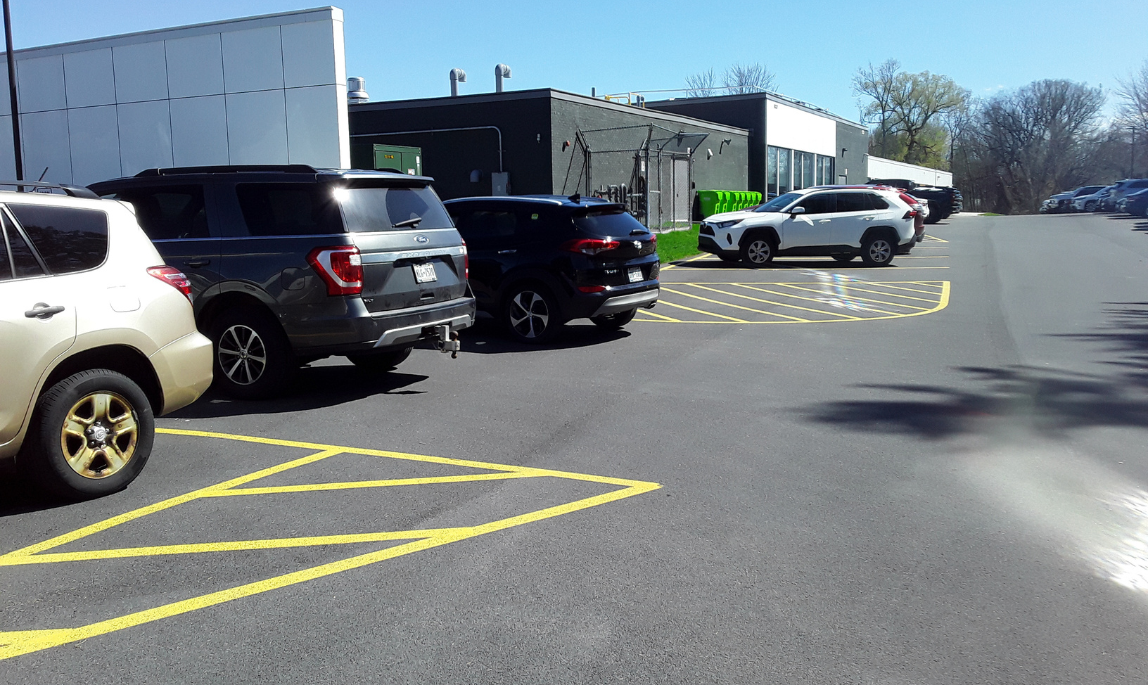
DIRECTIONS
4th -
Students will be released in groups
Group 1
Load your child into your car
Leave the pick-up, parking area in an orderly fashion as it transitions back into a single file line
Group 2 and so on
When you pull ahead, into the 2 lane area, alternate with car in front of you,
if they go left you go right
and vice a versa

Slide 8
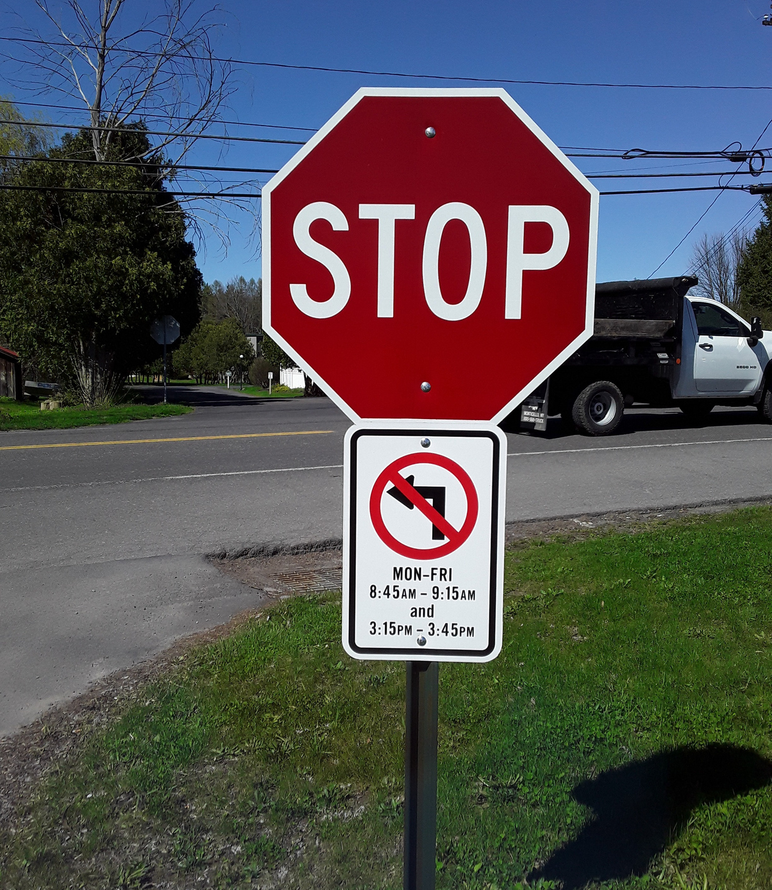
DIRECTIONS
Last
DO NOT try to TURN LEFT
out of the parking lot
This causes backups and delays the dismissal process for all
BE RESPECTFUL & COURTEOUS

Slide 9
THANK-YOU
If you know you are going to be an Everyday Pick-Up,
or have a
Regular Pick-Up Day -
If you are coming to school to drop of supplies, tour classrooms, etc. stop at the office and ask if you can get your ID checked and get your Window Card
BE PREPARED FOR THE 1ST DAY
OF SCHOOL

