Slide 1
North Syracuse Central School District
Budget Proposal
2020-21
May 2020

Slide 2
Headlines – Events Impacting Schools and School Budgets
New York faces its largest budget crisis in a decade.
WHO declares the coronavirus outbreak a pandemic
Coronavirus Increases New York State Budget Deficit
State Comptroller Tom DiNapoli says the current $6 billion deficit will grow to $10 or $13 billion.
Coronavirus: New York has more cases than any country
The State is Broke And Upstate Counties Are Worried

Slide 3
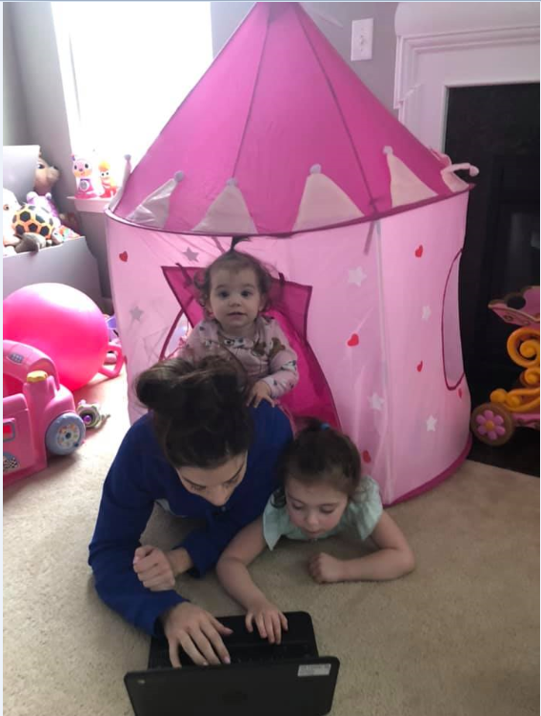
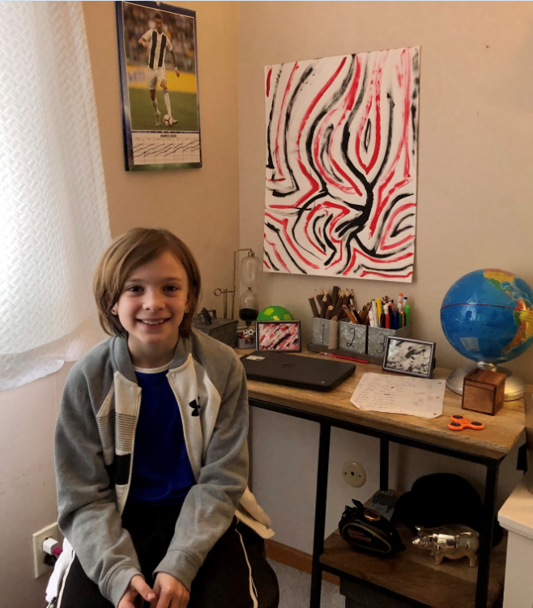

Slide 4
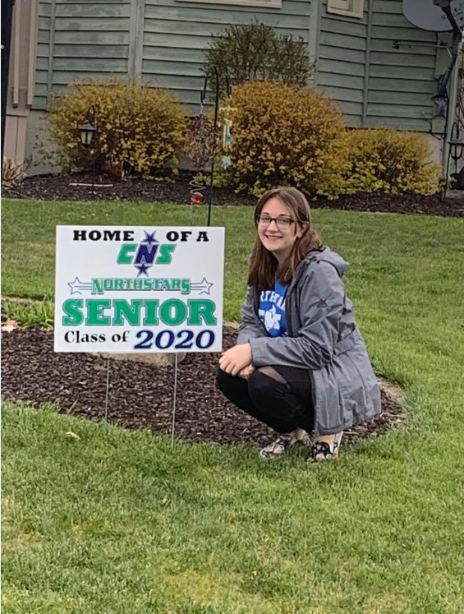
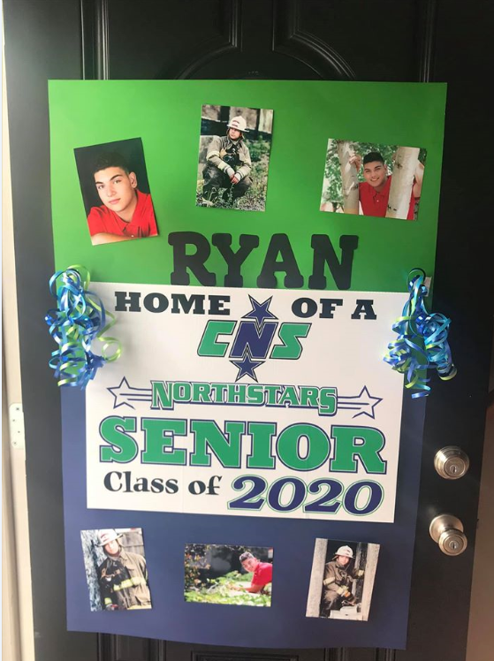
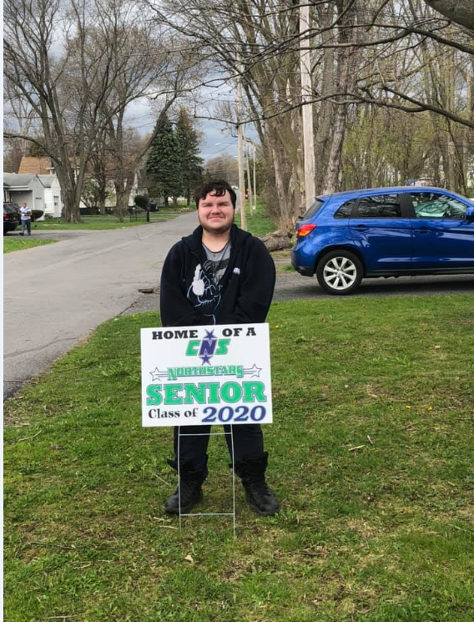

Slide 5
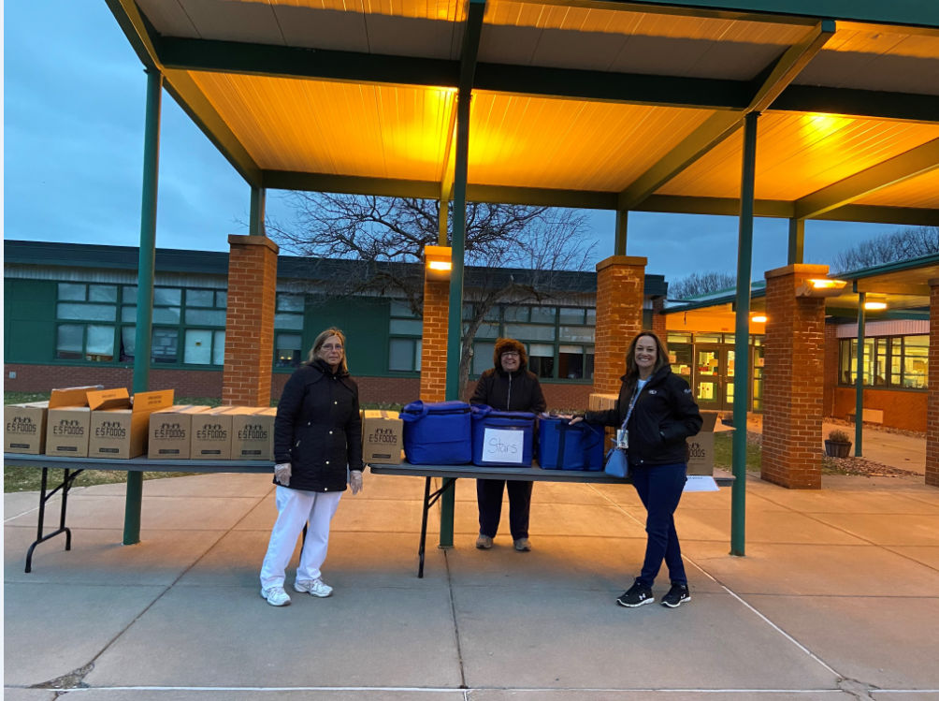

Slide 6
Agenda
Revenues
State Aid
Foundation Aid Funding Shortfall
Tax Levy & Tax Cap Calculation
Proposed Expenditure
Reductions Required to Balance the Budget
Proposed Additions
Vehicle Bonding Proposition
Fund Balance & Reserves
Vote & Election Information

Slide 7
Revenue Assumptions
General State Aid:
Based on the Final NYS Budget approved by Legislature.
State Aid subject to change quarterly based on actual state revenues.
Building Aid:
The 2020-21 budget is not impacted by the penalty waiver signed by the governor in August 2018. The refund was received and appropriated for the KWS Bear Road project.
Building Aid is lower than last year due to the fact that our debt service is lower.
Pandemic Adjustment & Cares Restoration Aid
Revenues include a reduction by NYS of $1,404,329 called the Pandemic Adjustment. This amount has been offset by federal funds of the same amount called the Cares Restoration Aid.
Real Property Taxes:
The increase in the levy is limited to the amount of the tax cap. The largest component is inflation based on CPI as reported by the Bureau of Labor Statistics for 2019, 1.81%.
Smart Schools Bond Act:
We continue to use Smart Schools funds to invest in technology. Revenues will NOT impact the General Fund.

Slide 8
Revenues $172,567,744
Notes:
Donald

Slide 9
Revenues
 | 2019-2020 | 2020-2021 | Variance
General State Aid | $64,945,776 | $67,044,979 | $2,099,203 | 3.23%
PILOTS | $379,161 | $424,408 | $45,247 | 11.93%
Sales Tax | $300,000 | $350,000 | $50,000 | 16.67%
Interest | $200,000 | $450,000 | $250,000 | 125.00%
Fund Balance | $3,750,000 | $4,000,000 | $250,000 | 6.67%
Rent | $404,000 | $404,000 | $0 | 0.00%
Use of General Reserve | $0 | $1,000,000 | $1,000,000 | N/A
Medicaid | $450,000 | $550,000 | $100,000 | 22.22%
Other Revenue | $2,187,900 | $2,150,000 | ($37,900) | (1.73%)
Sub Total | $72,616,837 | $76,373,387 | $3,756,550 | 5.17%
Building Aid | $3,934,238 | $3,649,402 | ($284,836) | (7.24%)
Tax Levy | $90,209,332 | $92,544,955 | $2,335,623 | 2.59%
Total | $166,760,407 | $172,567,744 | $5,807,337 | 3.48%
Notes:
Donald

Slide 10
State Aid as Approved by NYS Legislature
 | Approved | Approved | Difference
 | Budget | Budget | $ | %
 | 2019-20 | 2020-21
Foundation Aid | 46,735,862 | 46,734,982 | (880) | 0.00%
Excess Cost - Private | 490,053 | 405,184 | (84,869) | -17.32%
Excess Cost - Public | 2,975,653 | 4,374,999 | 1,399,346 | 47.03%
Subtotal | 50,201,568 | 51,515,165 | 1,313,597 | 2.62%
Hardware & Technology | 158,087 | 156,093 | (1,994) | -1.26%
Software, Library, Textbook, | 706,892 | 690,449 | (16,443) | -2.33%
Transportation | 8,272,152 | 8,753,081 | 480,929 | 5.81%
BOCES | 5,307,077 | 5,930,191 | 623,114 | 11.74%
Subtotal | 14,444,208 | 15,529,814 | 1,085,606 | 7.52%
Total (Without Building Aid) | 64,645,776 | 67,044,979 | 2,399,203 | 3.71%
Building Aid | 3,934,238 | 3,649,402 | (284,836) | -7.24%
Pandemic Adjustment | - | (1,404,329) | (1,404,329) | N/A
Federal Cares Restoration | - | 1,404,329 | 1,404,329 | N/A
TOTAL STATE AID | 68,580,014 | 70,694,381 | 2,114,367 | 3.08%
Universal Pre-K | 606,120 | 606,120 | 0 | 0.00%
TOTAL STATE AID w/ Pre-K | 69,186,134 | 71,300,501 | 2,114,367 | 3.06%

Slide 11
State Aid Implications for NSCSD
Foundation Aid continues to be an issue. The final State Aid has NO INCREASE in Foundation Aid.
We anticipated the drop off in building aid consistent with final debt payments made on older capital project debt. This timing is perfect as we begin the renovation of KWS Bear and complete roof projects over the next few years that will result in new debt.
Our total projected State Aid increase under the final budget proposal is 3.06% or $2.1 million. This is all due to expense-driven aides resulting from increased spending by the District in Special Education, Transportation and BOCES.

Slide 12
Foundation Aid Funding Shortfall
NYS has not fully funded Foundation Aid in accordance with the Laws of 2007 which required distribution of funds to school districts based on the cost of providing a sound basic education and adjusted to reflect regional costs.
NSCSD will receive $13.1 million less in 2020-21 than the full phase in level. Since 2007-08 we have received $178 million less in Foundation Aid than contemplated by the legislated formula.
The distribution of Foundation Aid to schools across the state is inequitable. School Districts with significantly higher wealth ratios receive a higher % of their Foundation Aid than NSCSD. We receive only 78% of the aid we are supposed to receive.

Slide 14
Tax Cap Calculation
Tax Levy 2019-2020: $90,209,332
Tax Base Growth Factor: x 1.0073
90,867,860
PILOT Revenue for 2019-2020: 379,161
Tax Levy for Capital for 2019-2020: (2,311,997) 88,935,024
Allowable Levy Growth Factor: x 1.0180
90,544,748
Estimated PILOT Revenue for 2020-2021: (424,408)
Tax Levy for Capital for 2020-2021: 2,442,615
Other Exclusions (ERS & TRS > 2%): 0
Available Carryover: 0
Tax Levy Limit Plus Exclusions: $92,544,955
Tax Levy Limit Increase: $ 2,335,623 (2.59%)
Estimated tax levy increase on a home of $100,000 BEFORE STAR is $61

Slide 15
Projected School Tax Rates & Amounts
2020-2021 (2.59% Increase)
 |  |  | Cicero |  | Clay |  | Salina
FULL VALUE |  |  | $ 100,000 |  | $ 100,000 |  | $ 100,000
ASSESSED VALUE (AV) |  |  | $ 100,000 |  | $ 4,000 |  | $ 100,000
EST. TAX RATE
PER $1,000 OF AV |  |  | $ 24.21 |  | $ 605.42 |  | $ 24.21
EST. ANNUAL
SCHOOL TAX |  |  | $ 2,421 |  | $ 2,421 |  | $ 2,421
TAX INCREASE YR./MO. |  |  | $61/$5.08 |  | $61/$5.08 |  | $61/$5.08
These calculations exclude the benefits of STAR

Slide 16
Tax on True Value CNY Districts ($/$1,000 2018 Data from Office of NYS Comptroller)

Slide 17
EXPENDITURE ASSUMPTIONS
Health Benefits:
We are hopeful that the positive trend continues and that NSCSD will experience lower than average increases for our industry. We are projecting a 6% increase for 2020-21.
Retirement Costs:
TRS – The TRS Board met this fall. They estimate that the Employer Contribution Rate (ERC) for 2020-21 will be in the 9.53%. This will be an increase from the 8.86% for the current school year.
ERS - The 2020-21 contribution rate for the Employee Retirement System (ERS) will be slightly higher, going from 15.7% to 16.0% of salaries.
Salaries & Wages:
Many contracts were renegotiated effective June 30, 2019 and budgeted salaries and wages reflect increases included in the new agreements. The proposed budget includes both position eliminations and new positions for 2020-21 as outlined in this presentation.
Fuel Costs (Transportation):
Over the past few years this has been a favorable (but volatile) market. However, we must consider “net of aid savings” only due to transportation aid (78.5%).
Energy Costs (Gas & Electric):
Through BOCES, the district participates in an energy consortium (NYSMEC) that enters into a 3-year supply agreement. The current agreement covers 2018-19 through 2020-21 school years. Our budget will reflect contracted rates based on estimated usage.

Slide 18
Expenditures $172,567,744
Notes:
Donald

Slide 19
Proposed Expenditures
 | 2019-2020 | 2020-2021 | Variance
Salaries | $79,660,373 | $80,880,165 | $1,219,792 | 1.53%
Benefits | $51,176,731 | $53,593,785 | $2,417,054 | 4.72%
Debt Service | $7,583,653 | $7,286,719 | ($296,934) | (3.92%)
Contractual | $7,259,062 | $8,671,646 | $1,412,584 | 19.46%
BOCES | $16,827,615 | $17,725,000 | $897,385 | 5.33%
Equipment | $616,840 | $616,400 | ($440) | (0.07%)
Supplies & Other | $3,536,133 | $3,694,029 | $157,896 | 4.47%
Special Project | $100,000 | $100,000 | $0 | 0.00%
Total | $166,760,407 | $172,567,744 | $5,807,337 | 3.48%
Notes:
Donald

Slide 20
Required Budget Reduction Elementary Enrollment Related (K-6)
Class Sizes have been declining for the past few years due to staff additions along with declining enrollment.
Elementary enrollment declined from 4,580 in 2015-16 to 4,226 in 2019-20 or (7.7%).
Elementary staffing (teachers) increased from 202 in 2015-16 to 217 in 2019-20 or 7.5%.
For 2020-21 we are proposing a reduction of 7 teacher positions.
Class sizes for 2020-21 remain well below both guidelines and contractual requirements. The projected student teacher ratios are conducive to meeting the needs of both students & District staff.

Slide 21
Required Budget Reduction Middle School Schedule
The Middle School Schedule PILOT which occurred during the 2019-20 school year allowed us to offer students a broader offering of academic opportunities.
However, the additional courses offered were not required by NYS and the cost of the program exceeds the financial capacity of the District.
Therefore, in light of the current budget deficit, 9 middle school positions that were created to facilitate the new schedule will be eliminated and the Middle School Schedule will revert back to the 2018-19 schedule and staffing.
State mandated counselors and ENL positions hired over the past year will remain.

Slide 22
Required Budget Reduction Secondary Enrollment Related
We have worked hard to expand offerings for students at C-NS and NSJH as part of Vision 2020 to prepare students for college and careers.
Due to declining enrollment over the past 4 years, the proposed budget eliminates 7.65 positions in various tenure areas.
Student/teacher ratios, class sizes and case loads will still remain well within guidelines and contractual requirements.

Slide 23
Required Budget Reduction Teachers on Special Assignment
Over the past four years, we have invested heavily in teacher training and support in several areas through the use of instructional coaches.
This training and support has been valuable to teachers and has improved instruction. We are proud and appreciative of the important work the teachers on special assignment have achieved.
Due to the budget deficit, the following teachers on special assignment would return to the classroom:
1 Co-Teaching Coach
2 Literacy Coaches

Slide 24
Required Budget Reductions Special Education
Over the past 4 years, the District has significantly increased staffing associated with our special education programs despite a nominal increase in the special education student population.
The District has increased the number of special education teachers by 21 positions and the number of teaching assistants by 27, increases of 29% and 30% respectively.
In order to improve the economic efficiency of delivering special education services, while still meeting the student needs as documented in the Individual Education Plans (IEPs), the following reductions are proposed:
10 Teaching Assistant positions
4 Consultant Teacher Direct (CTD) Teacher positions

Slide 25
Required Budget Reductions PAR Panel – Consultant Teachers
Through the Peer Assistance & Review (PAR) process, NSCSD has done an outstanding job supporting new teachers during their first years with the District leading up to the granting of tenure.
Due to the decline in hiring along with position eliminations proposed in the 2020-21 budget, the number of Consultant Teacher (CT) positions required to support our newest teachers has declined.
In addition, we propose reduces the coaching period to the first 2 years that a teacher works for NSCSD, further reducing the need for CT.
The 2020-21 Budget proposal includes the elimination of 5 CT positions.
The remaining 4 CTs will be able to meet the needs of our newest teachers.

Slide 26
Required Budget Reductions Administration
During the last financial crisis, several administrative cuts were made along with cuts to instructional programs and positions. Appropriately, instructional programs and positions, including athletics, were fully restored as a priority over the past 5 years.
On the operations side, the District still lacks Directors of Security and Technology and does not have a Grounds Crew Leader.
The District’s administrative ratio continues to be less favorable than its peers, due to administrative position cuts made but not restored; for example, middle school assistant principals cut in 2010-11 & 2013-14.
The Board previously approved the addition of a Math Director but the hiring of this position will be delayed until the District is in a better financial position.
The IT Systems Administrator will be retiring in 2020-21 and the position will be eliminated.

Slide 27
Administrative Ratios – Large CNY Districts Ratio of Students Per Administrator
Ratio
161.2:1
190.0:1
175.5:1
171.7:1
NSCSD

Slide 28
Vision 2020 Initiative Social Emotional Learning
Increase Social Emotional support for students at C-NS.
Add an Administrative Assistant for Student Services at C-NS to meet the increased needs of the building.
Provide additional social worker or counselor support for Cicero and Allen Road Elementary.
2 psychologist interns will support students District-wide.
Continue partnerships with Liberty Resources and Contact.
The proposed increase in counselor staffing will allow ADA-PEP to function with greater focus.

Slide 29
Vision 2020 Initiative Career & Technical Education
Additional course offerings at C-NS.
Expand Live Event Production courses.
Courses under development for new technologies such as drones.
C-NS Career Center will continue to provide opportunities for students to explore career options.
Continue to foster opportunities for students through BOCES programs – 47 students earned CTE endorsements on their HS diplomas in 2019.

Slide 30
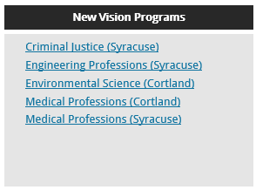
BOCES CTE & New Visions Programs

Slide 31
Summary of Proposed Budget Additions
What | Where | Dollar Amount
Administrative Assistant for Student Support | C-NS | $81,865
Master Mind Competition Advisor | C-NS | $2,380
Unified Bowling | C-NS | $2,200
Grade 7 Teachers due to Enrollment (1.0 FTE) | GRMS | $81,865
ENL due to Enrollment (0.3 FTE) | GRMS | $24,559
School Psychologist Interns (2.0 FTE) | District-wide | $30,000
RTI/ELA Coordinator | District-wide | $81,865
Social Worker * | Allen Road | $81,865
Social Worker (0.5 FTE) ** | Lakeshore Road | $40,932
Security Guard ** | Lakeshore Road | $47,109
Nurse | Lakeshore / District-Wide | $81,865
Teacher’s Aide (0.5 FTE) | Lakeshore Road | $13,060
Total |  | $569,565
* the hiring of this position allows the counselor, who previously service both CE and ARE, to service CE full time.
** temporarily required due to the increased number of students and staff at LRE during BRE construction.

Slide 32
Summary of Personnel Changes
Area | Position | FTE | Amount
Elementary | Teacher | -7.00 | -$489,037
Middle School | Teacher | -9.00 | -$628762
Secondary | Teacher | -7.65 | -$534,448
Teachers on Special Assignment | Coaches | -3.00 | -$209,587
Special Education | Teaching Assistants & Teachers | -14.00 | -$588,570
PAR Panel | Consultant Teachers | -5.00 | -$349,312
Administration | Math Director & Systems Administrator | -2.00 | -$201,700
From Previous Slide | Various | +7.50 | $569,565
Net Reductions |  | -40.15 | -$2,431,851

Slide 34
Expenditure Per Pupil - OCM BOCES Component Districts Only
School | Spending Per Pupil | State Rank
1 | $29,485 | 183
2 | $28,789 | *213
3 | $28,365 | *222
4 | $27,525 | *253
5 | $26,194 | 317
6 | $24,840 | *394
7 | $24,685 | 401
8 | $23,844 | 447
9 | $23,738 | 453
10 | $22,496 | 513
11 | $22,489 | 512
School | Spending Per Pupil | State Rank
12 | $21,831 | 554
13 | $21,688 | *560
14 | $21,675 | 561
15 | $21,203 | 589
16 | $20,965 | 601
17 | $20,310 | 624
North Syracuse | $20,081 | 633
19 | $19,489 | *647
20 | $19,296 | *651
21 | $19,224 | 654
22 | $19,201 | 655
23 | $19,114 | 658
Source: Forecast 5 - 5Sight data from NYSED ST-3 filings for 2018 (General Fund & Special Aid Fund only).
Large Districts in BOLD * denotes districts receiving greater than full phase in level of Foundation Aid
Notes:
Donald

Slide 35
Vehicle Bonding Proposition
Maintain the average age of our transportation fleet with a limited number of vehicles over 10 years old.
Reduce the cost of repairs and avoid problems associated with rusting frames that prevent the vehicles from passing D.O.T. inspection.
Purchasing gasoline engines again (first purchased in 2019-20).
Proposed purchases for 2020-21:
10 - 65-passenger gasoline engine school buses
2 - 42-passenger gasoline engine school bus with one to three wheelchair positions, hydraulic lift and air conditioning
6- trucks / Vans and mower for M&O to replace 15 year old vehicles
1-tow truck for transportation to replace 30 year old cable tow truck
Total estimated cost of all 20 vehicles is $2,113,295.
Tax Impact, after Trans Aid: approximately $2.38 per year for a house assessed at $100,000 before STAR.

Slide 37
Quarterly Adjustments by NYS Could Result in Further Expenditure Reductions Possible Percentages and Dollar Amounts
2020-21 | Total State Aid | Foundation Aid | Expense-Driven Aids
Possible Cut % | $ 70,694,381 | $ 46,737,982 | $ 23,956,399
1.0% | $ 706,943.81 | $ 467,379.82 | $ 239,563.99
2.0% | $ 1,413,887.62 | $ 934,759.64 | $ 479,127.98
3.0% | $ 2,120,831.43 | $ 1,402,139.46 | $ 718,691.97
4.0% | $ 2,827,775.24 | $ 1,869,519.28 | $ 958,255.96
5.0% | $ 3,534,719.05 | $ 2,336,899.10 | $ 1,197,819.95
6.0% | $ 4,241,662.86 | $ 2,804,278.92 | $ 1,437,383.94
7.0% | $ 4,948,606.67 | $ 3,271,658.74 | $ 1,676,947.93
8.0% | $ 5,655,550.48 | $ 3,739,038.56 | $ 1,916,511.92
9.0% | $ 6,362,494.29 | $ 4,206,418.38 | $ 2,156,075.91
10.0% | $ 7,069,438.10 | $ 4,673,798.20 | $ 2,395,639.90
11.0% | $ 7,776,381.91 | $ 5,141,178.02 | $ 2,635,203.89
12.0% | $ 8,483,325.72 | $ 5,608,557.84 | $ 2,874,767.88
13.0% | $ 9,190,269.53 | $ 6,075,937.66 | $ 3,114,331.87
14.0% | $ 9,897,213.34 | $ 6,543,317.48 | $ 3,353,895.86
15.0% | $ 10,604,157.15 | $ 7,010,697.30 | $ 3,593,459.85
16.0% | $ 11,311,100.96 | $ 7,478,077.12 | $ 3,833,023.84
17.0% | $ 12,018,044.77 | $ 7,945,456.94 | $ 4,072,587.83
18.0% | $ 12,724,988.58 | $ 8,412,836.76 | $ 4,312,151.82
19.0% | $ 13,431,932.39 | $ 8,880,216.58 | $ 4,551,715.81
20.0% | $ 14,138,876.20 | $ 9,347,596.40 | $ 4,791,279.80

Slide 38
UNASSIGNED FUND BALANCE Projected June 30, 2020
Unassigned Fund Balance at 6/30/19 (5.34% of Budget) $ 8,904,768
Refund from NYS for Final Cost Report Penalties $ (2,235,295) (1)
Estimated Revenue is lower than Budget 2019-20 $ (550,000)
Estimated Expenditures is lower than Budget 2019-20 $ 783,237 (2)
Projected Unassigned Fund Balance – 6/30/20 $ 6,902,710
Estimated Budget for 2020-2021: $ 172,567,744
Estimated Percentage of Budget: 4.0%
(1) Voters approved the appropriation of $2.3 million of Fund Balance to the KWS Bear renovation project in a referendum on December 17, 2019.
(2) This amount represents the favorable variance due to the spending freeze and closure of schools effective March 17th. Additional compensation costs due to recent contract negotiations were offset by favorable expense variances in medical, retirement, utilities and fuel.

Slide 39
Projected RESERVES June 30, 2020
July 1, 2019 June 30, 2020
Tax Certiorari $2,023,592 $2,051,922
Worker’s Compensation $2,131,529 $2,161,370
General Liability (a) $1,011,727 $ 25,891
Debt Service $1,939,084 $1,966,231
Capital (b) $2,506,211 $ 523,438
Total $9,612,143 $6,728,852
(a) This reserve is intended to be used (appropriated) in connection with 2020-21 budget.
(b) Voters authorized the establishment and funding of $2.5 million in September 2015. Approximately $2 million of these funds will be used in connection with roof projects approved by the voters in September of 2017.

Slide 40
Summary
The District remains underfunded with Foundation Aid, receiving over $13 million LESS than the fully funded amount.
The Tax Levy increase of 2.59% is at the tax cap, requiring a simple majority.
Unfortunately, current State Aid is insufficient and resulted in expenditure cuts. The net impact on personnel is that 40.15 positons were eliminated. Thankfully, due to retirements and leaves of absence only 3 people will be unemployed and 7 people will go from full time to part time, resulting in a loss of health benefits.
The Budget includes total revenues and expenditures of $172,567,744, which increased by $5,807,744 or 3.48%. The budget includes the appropriation of $4,000,000 of Fund Balance and the use of $1,000,000 in reserves.
Despite the proposed cuts, we are still able to provide our students with opportunities, reasonable class sizes and address their social and emotional needs.
We are hopeful that additional federal aid to NYS will preempt any further cuts in expenditures for 2020-21.

Slide 41
Vote & Election Tuesday, June 9, 2020 via US Mail
School board elections and budget votes originally scheduled for May 19, 2020 will now take place by mailed ballots, which must be received by 5:00 PM on June 9, 2020.
Qualified voters will receive an absentee ballot by mail with return postage paid by the District. Voters should complete their ballot and mail it back to the District in the postage paid envelope. In order for their ballot to be counted, the District must receive the mailed ballot by 5:00 PM on June 9, 2020.
There will be no minimum threshold number of signatures required for individuals to be placed on the ballot, except that they must meet all other requirements, including applicable residency and age.
Candidates will be listed on the ballot alphabetically. Board of Education candidate profiles will NOT be printed in the District Dispatch. All candidate profiles will be listed online ONLY with the submitted candidate photo.
The budget edition of District Dispatch will be sent electronically to households on May 15th and mailed to homes on May 22nd.
The Public Hearing meeting will take place on May 26th at 6:00 PM and will take place remotely via Zoom.

Slide 42
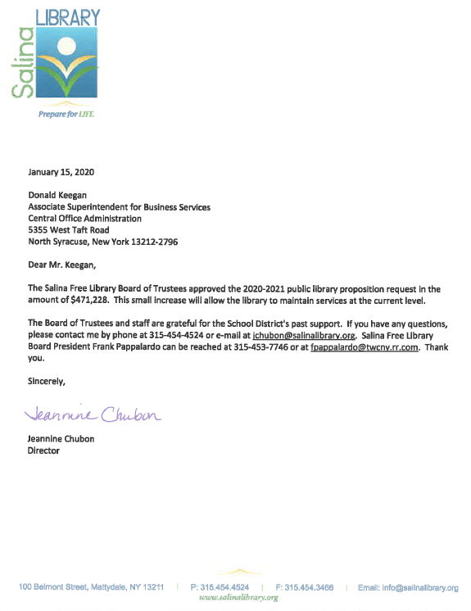
Salina
Library Proposition
2020-21 $471,228
2019-20 $458,393
Increase $ 12,838
Increase 2.8%
2020-21 $1.31
2019-20 $1.27
Increase $ .04

Slide 43
